Slide 1
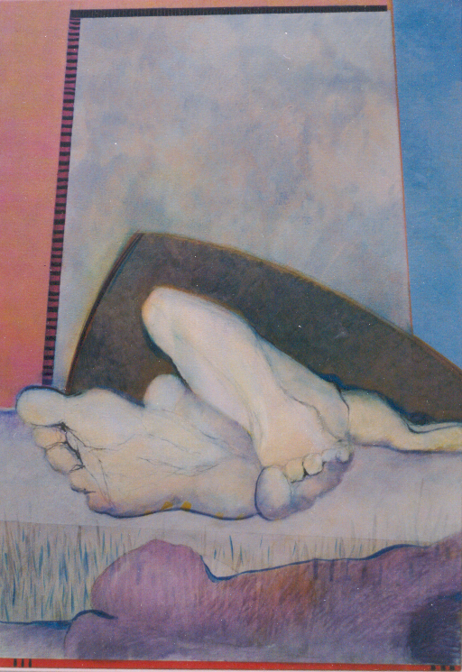
80 x 115 cm

Slide 2
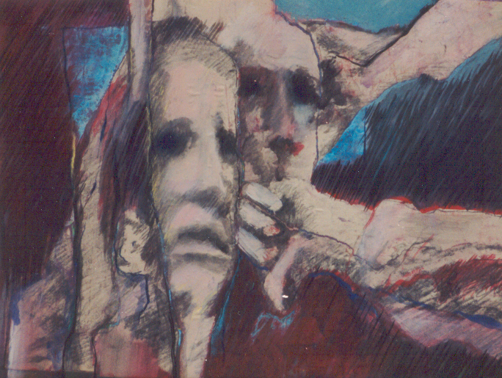
65 x 50 cm

Slide 3
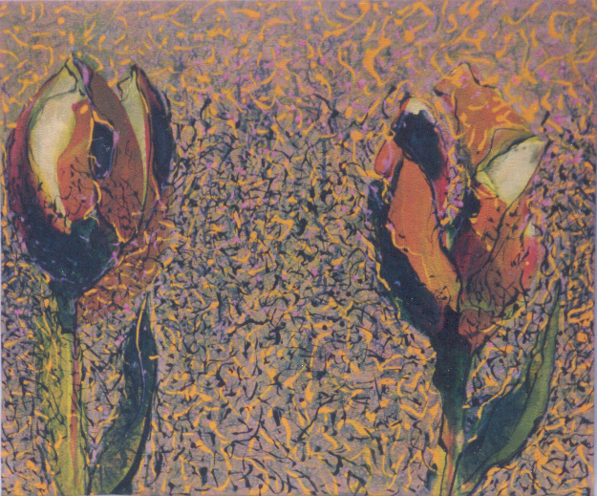
60 x 50 cm

Slide 4
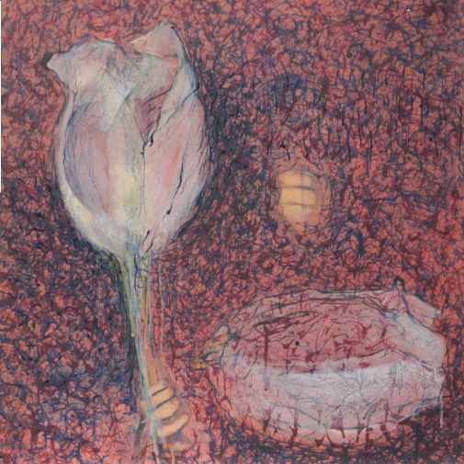
65 x 65 cm

Slide 5
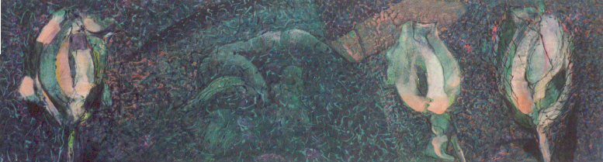
120 x 60 cm

Slide 6
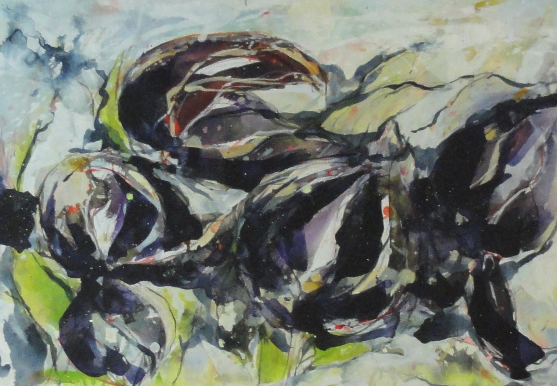
76 x 53 cm

Slide 7
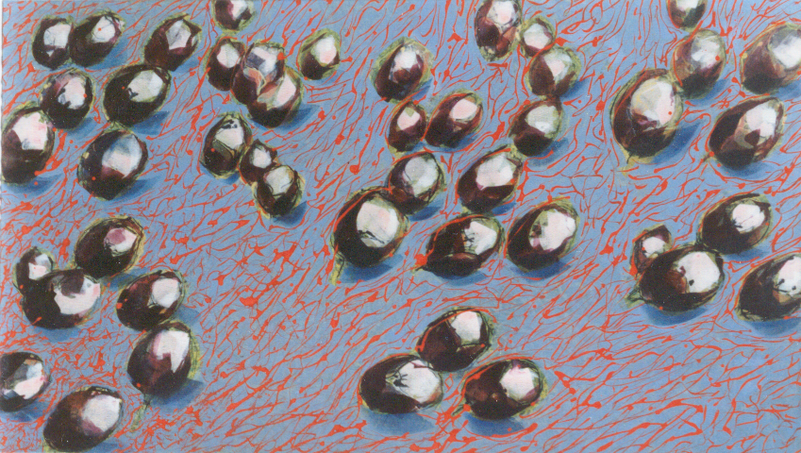
150 x 85 cm

Slide 8
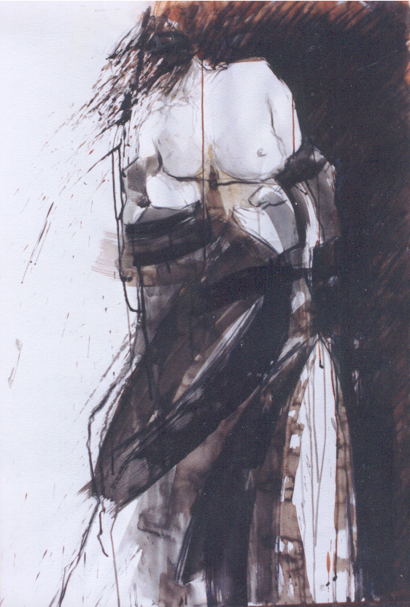
70 x 100 cm

Slide 9
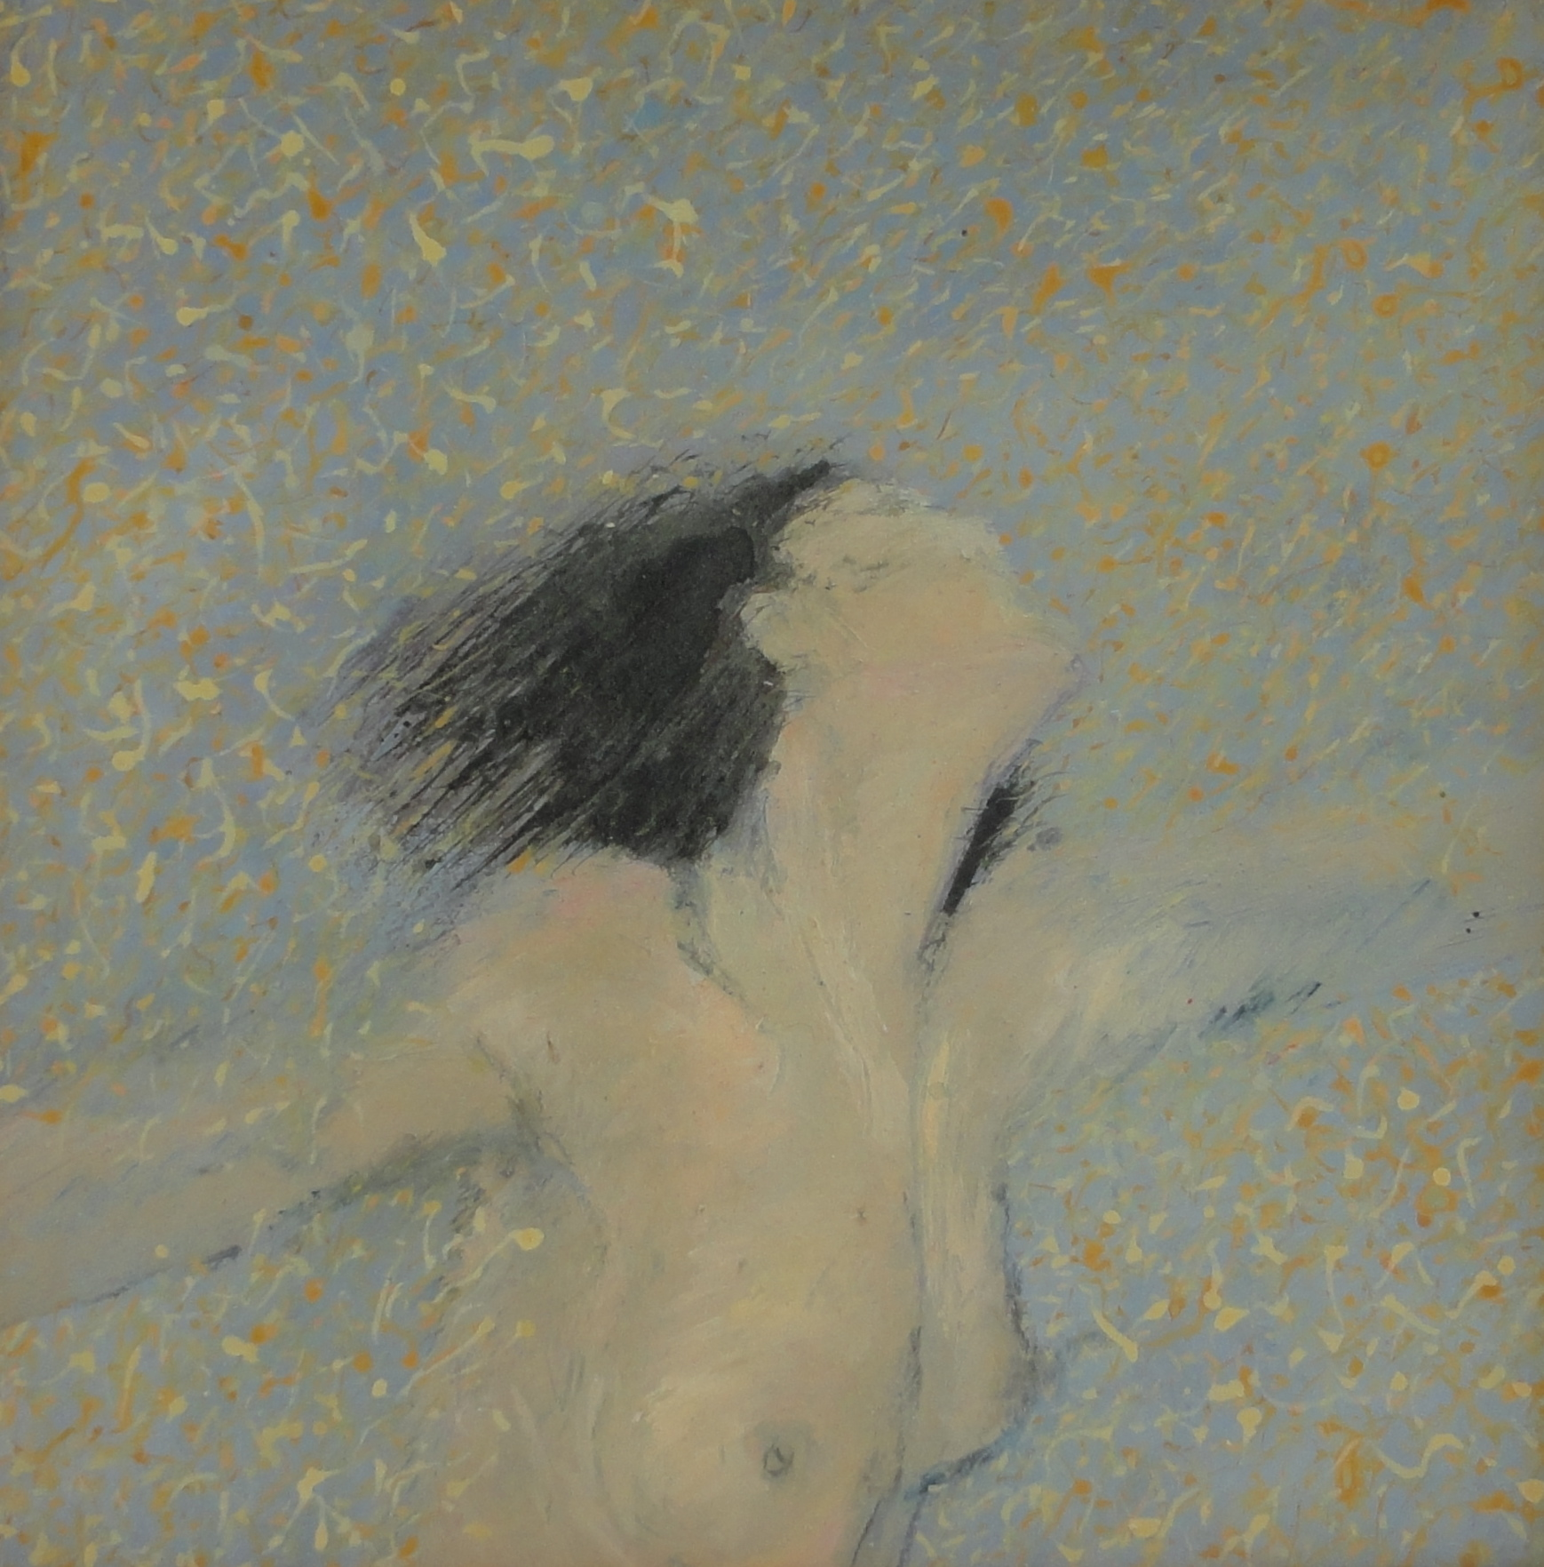
55 x 55 cm

Slide 10
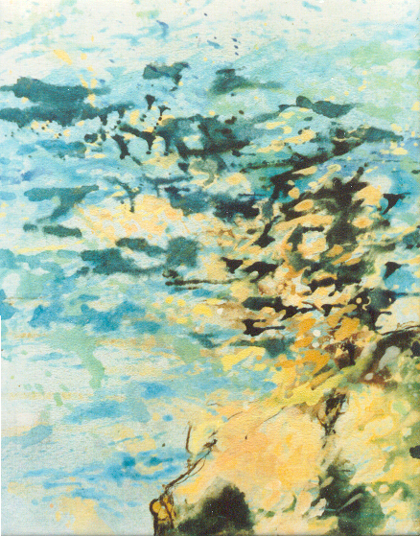
50 x 60 cm

Slide 11
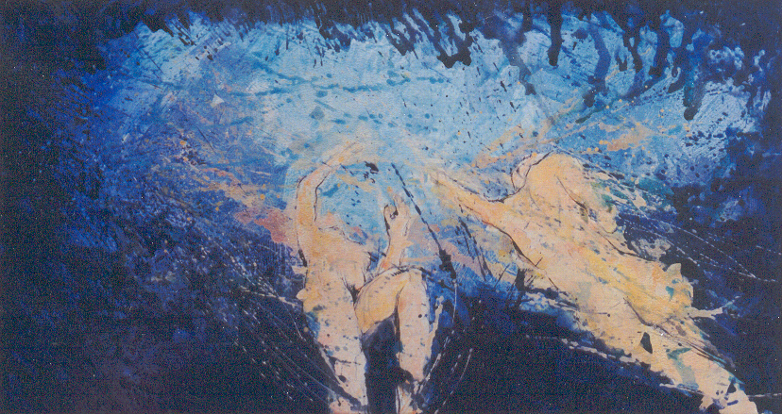
150 x 80 cm

Slide 12
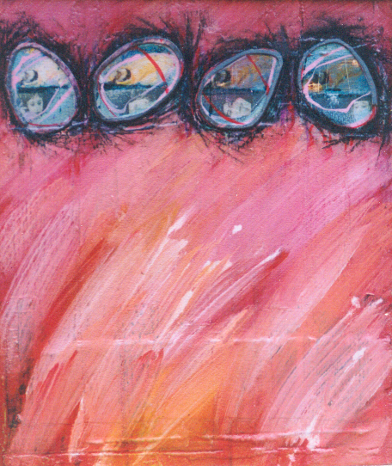
36 x 42 cm

Slide 13
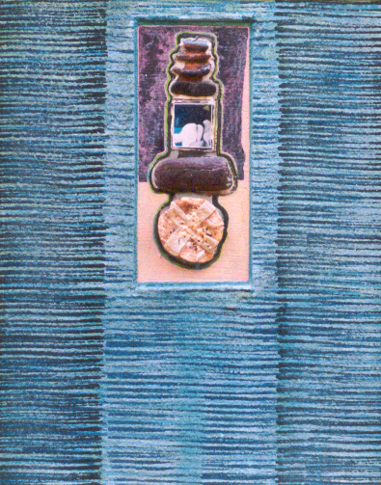
39 x 45 cm

Slide 14
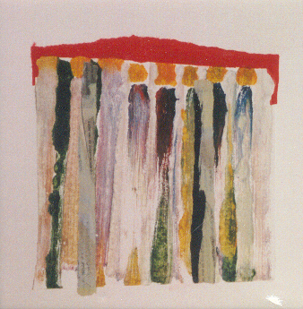
20 x 20 cm

Slide 15
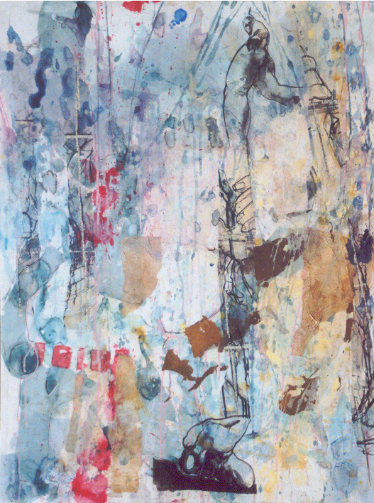
80 x 100 cm

Slide 16
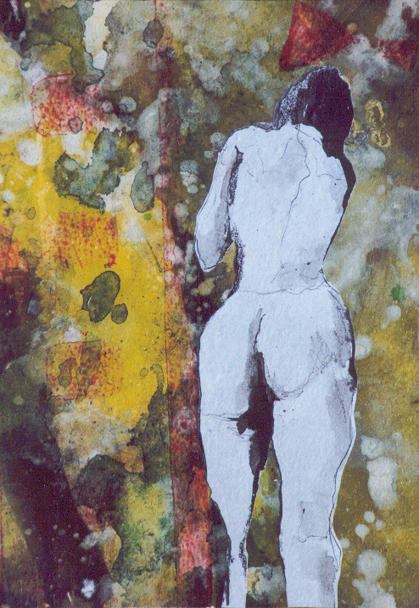
40 x 47 cm

Slide 17
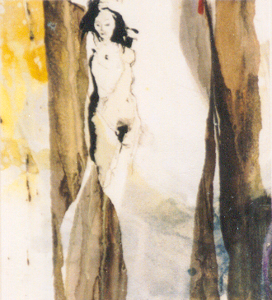
30 x 40 cm

Slide 18
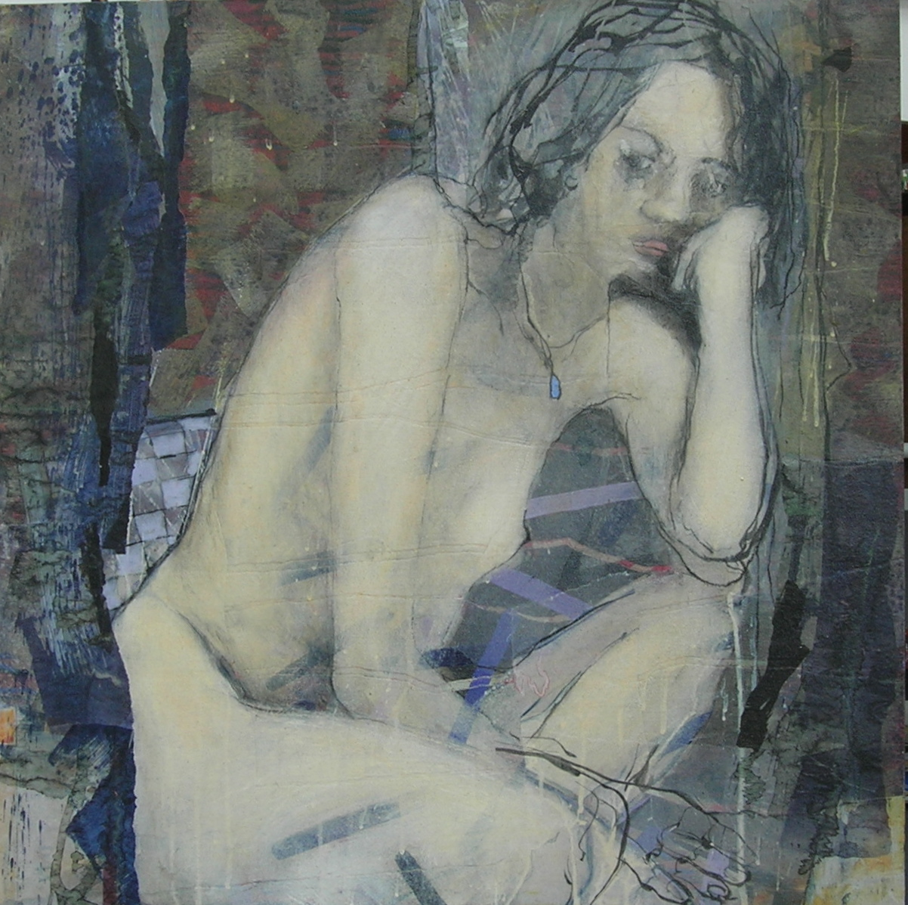
61 x 61 cm

Slide 19
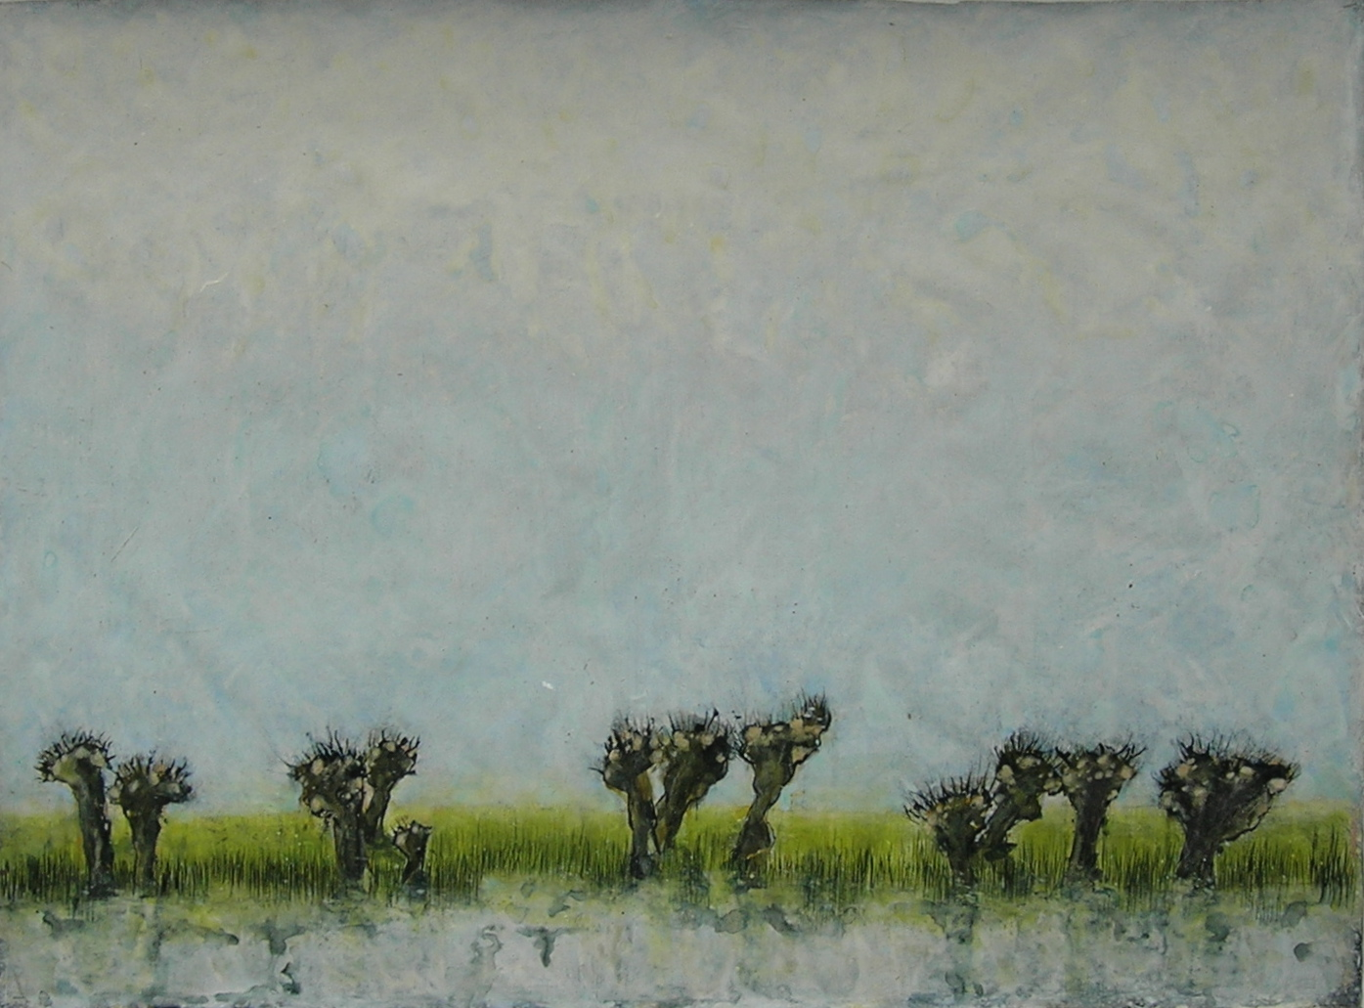
100 x 72 cm

Slide 20
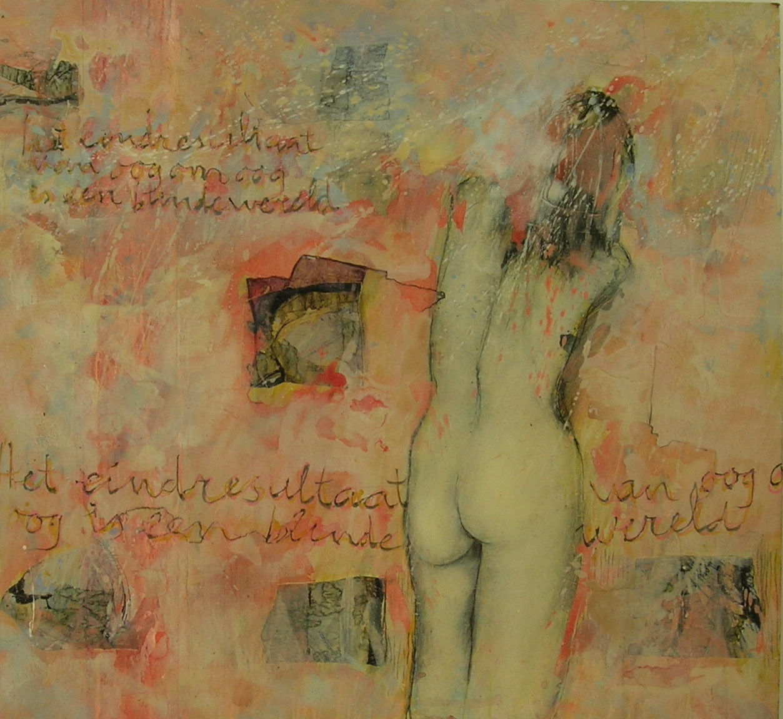
120 x 120 cm

Slide 21
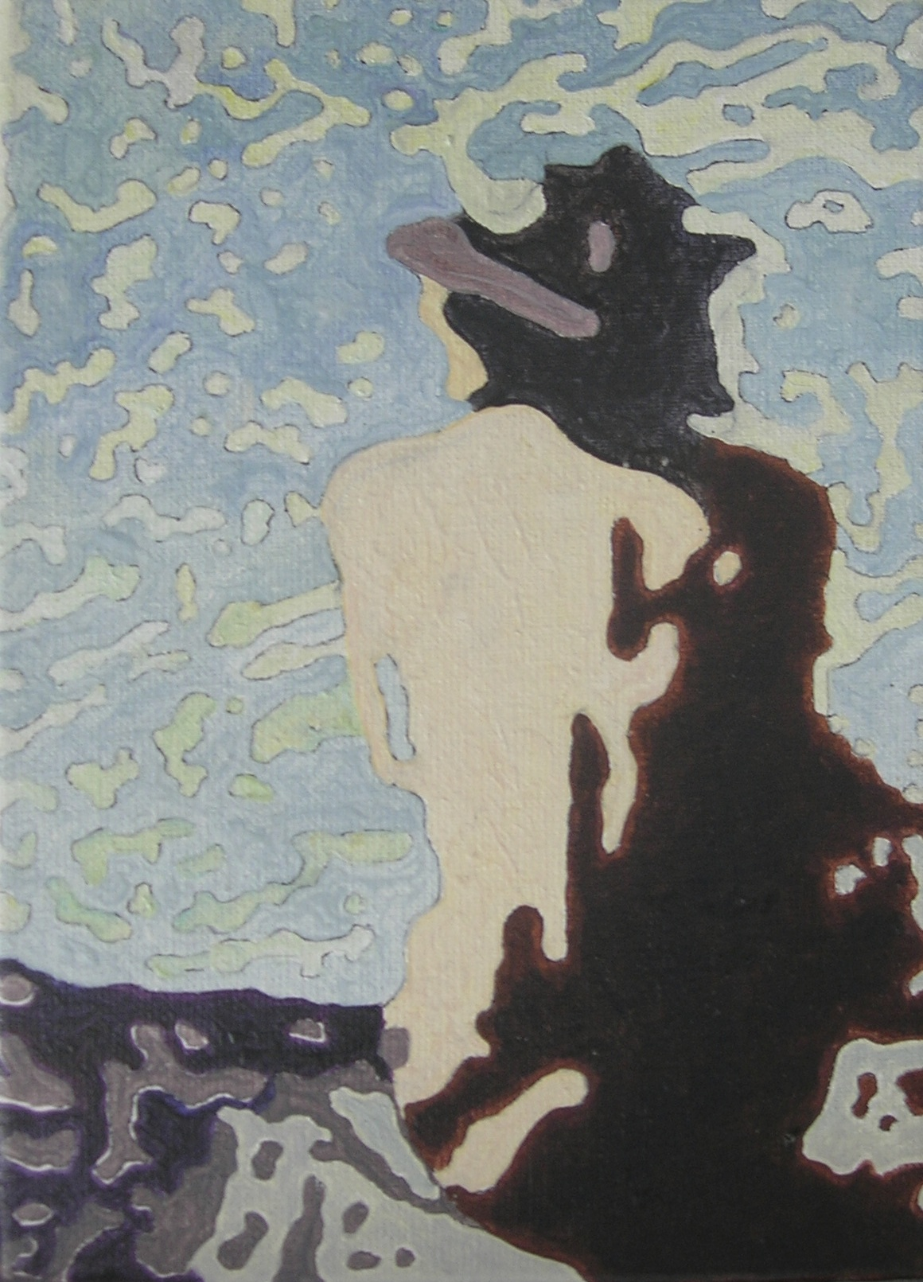
12 x 18 cm

Slide 22
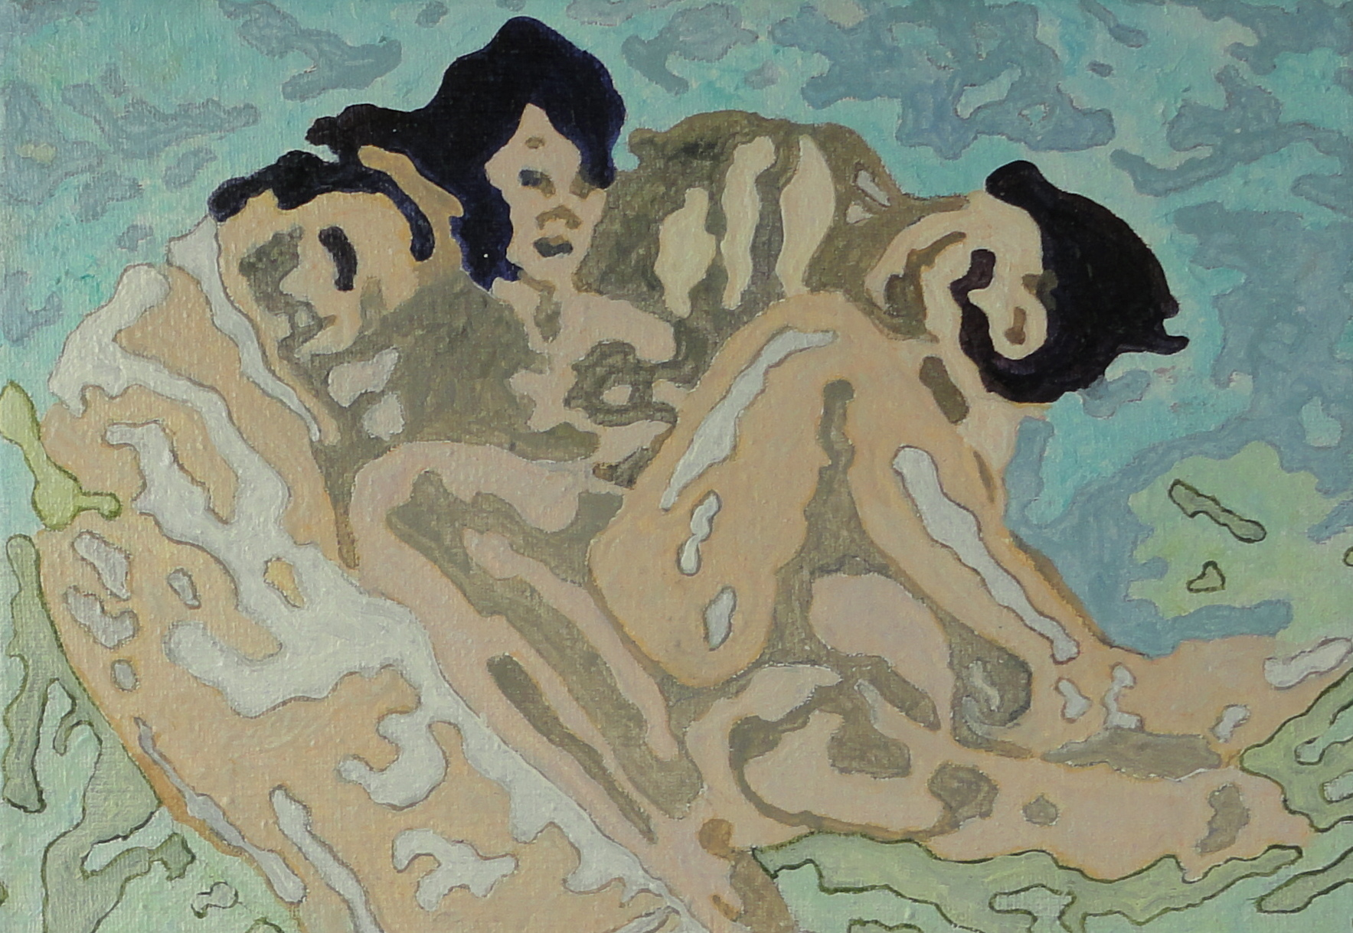
18 x 12 cm

Slide 23
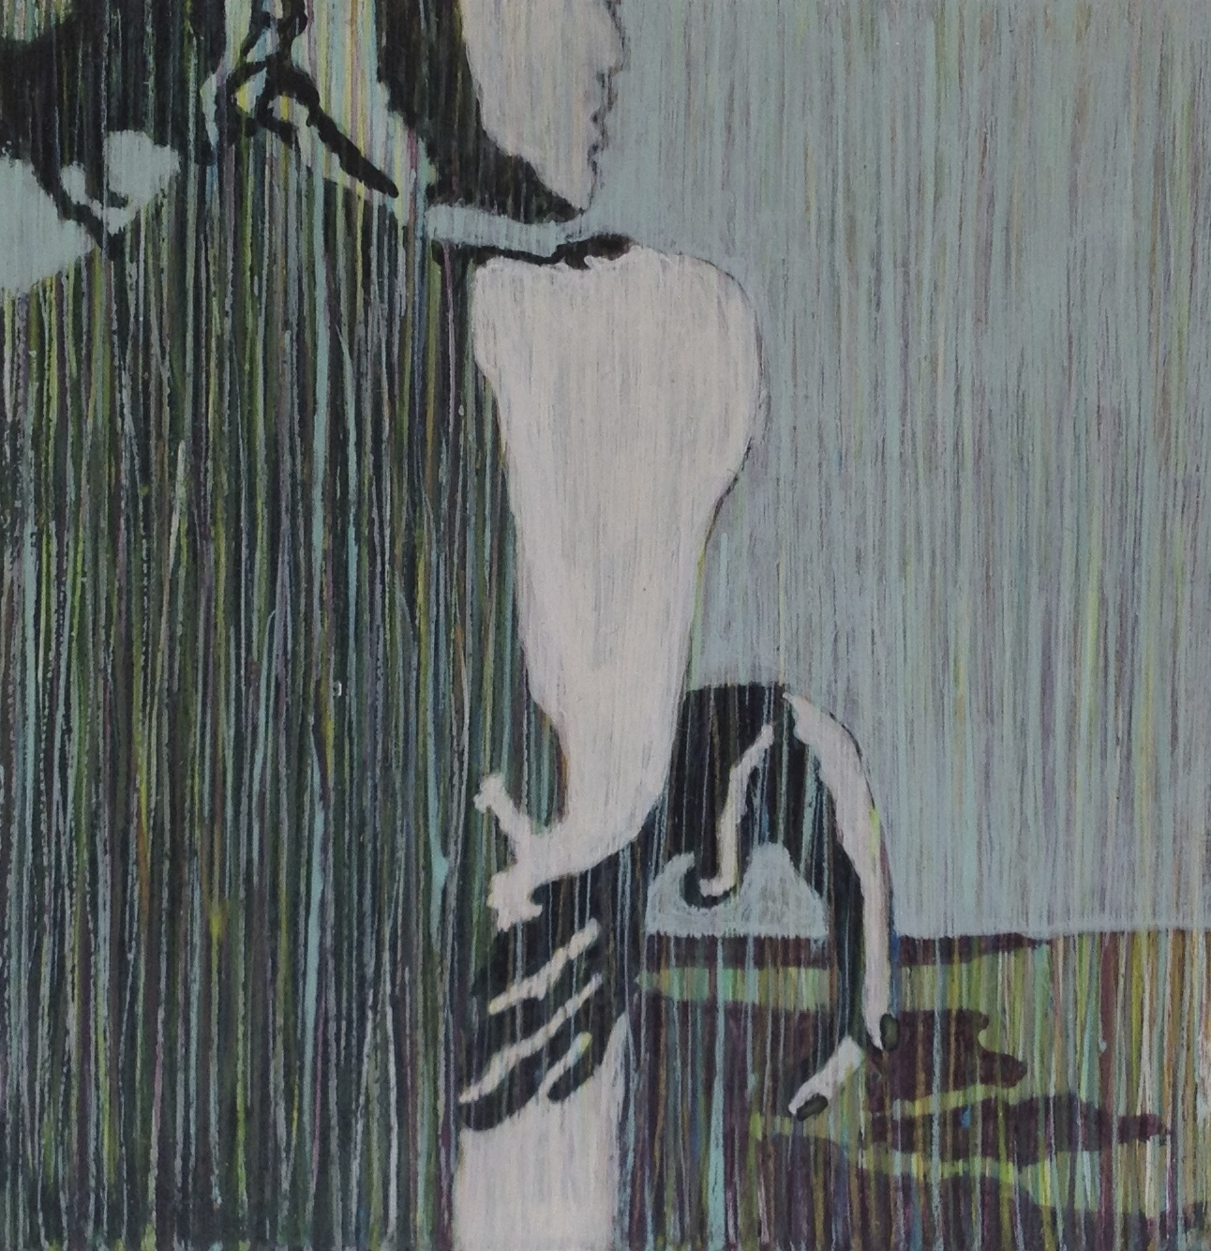
10 x 10 cm

Slide 24
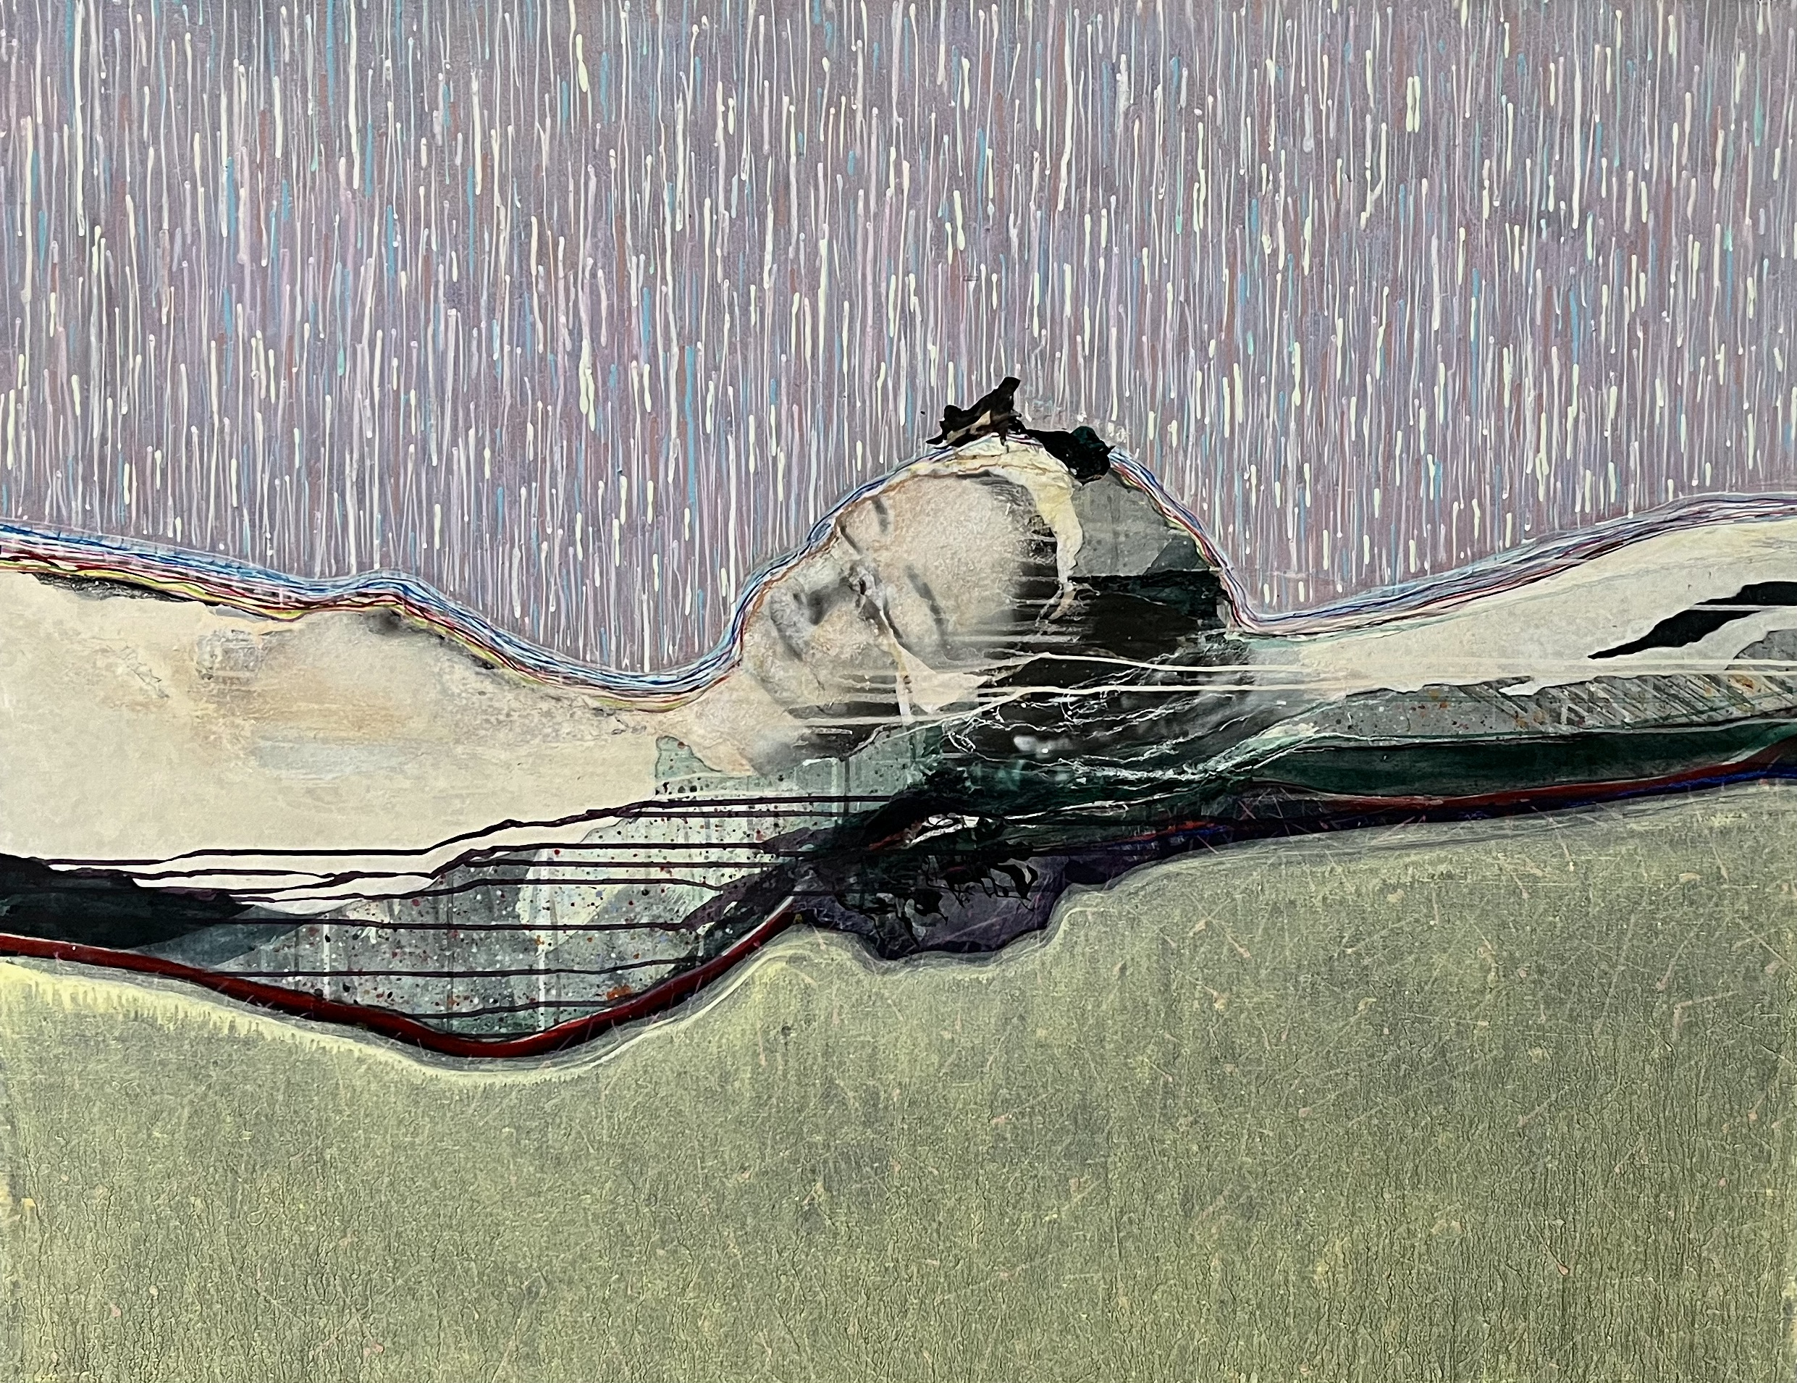
130 x 100 cm

Slide 25
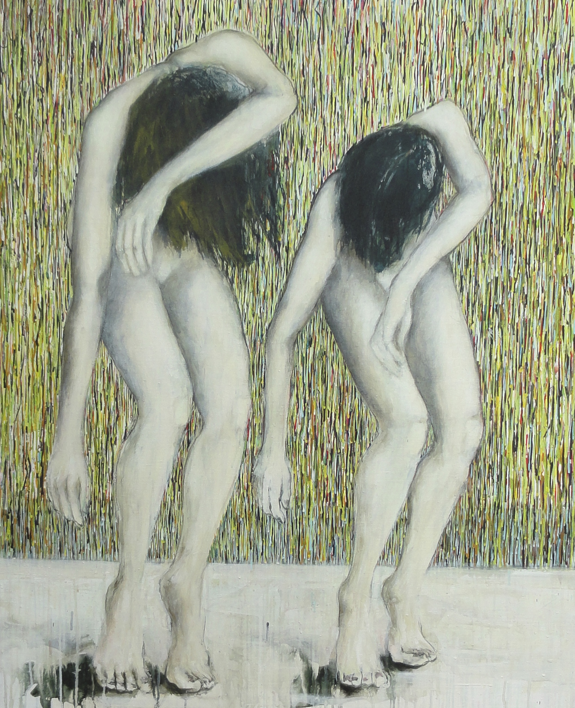
100 x 130 cm

Slide 26
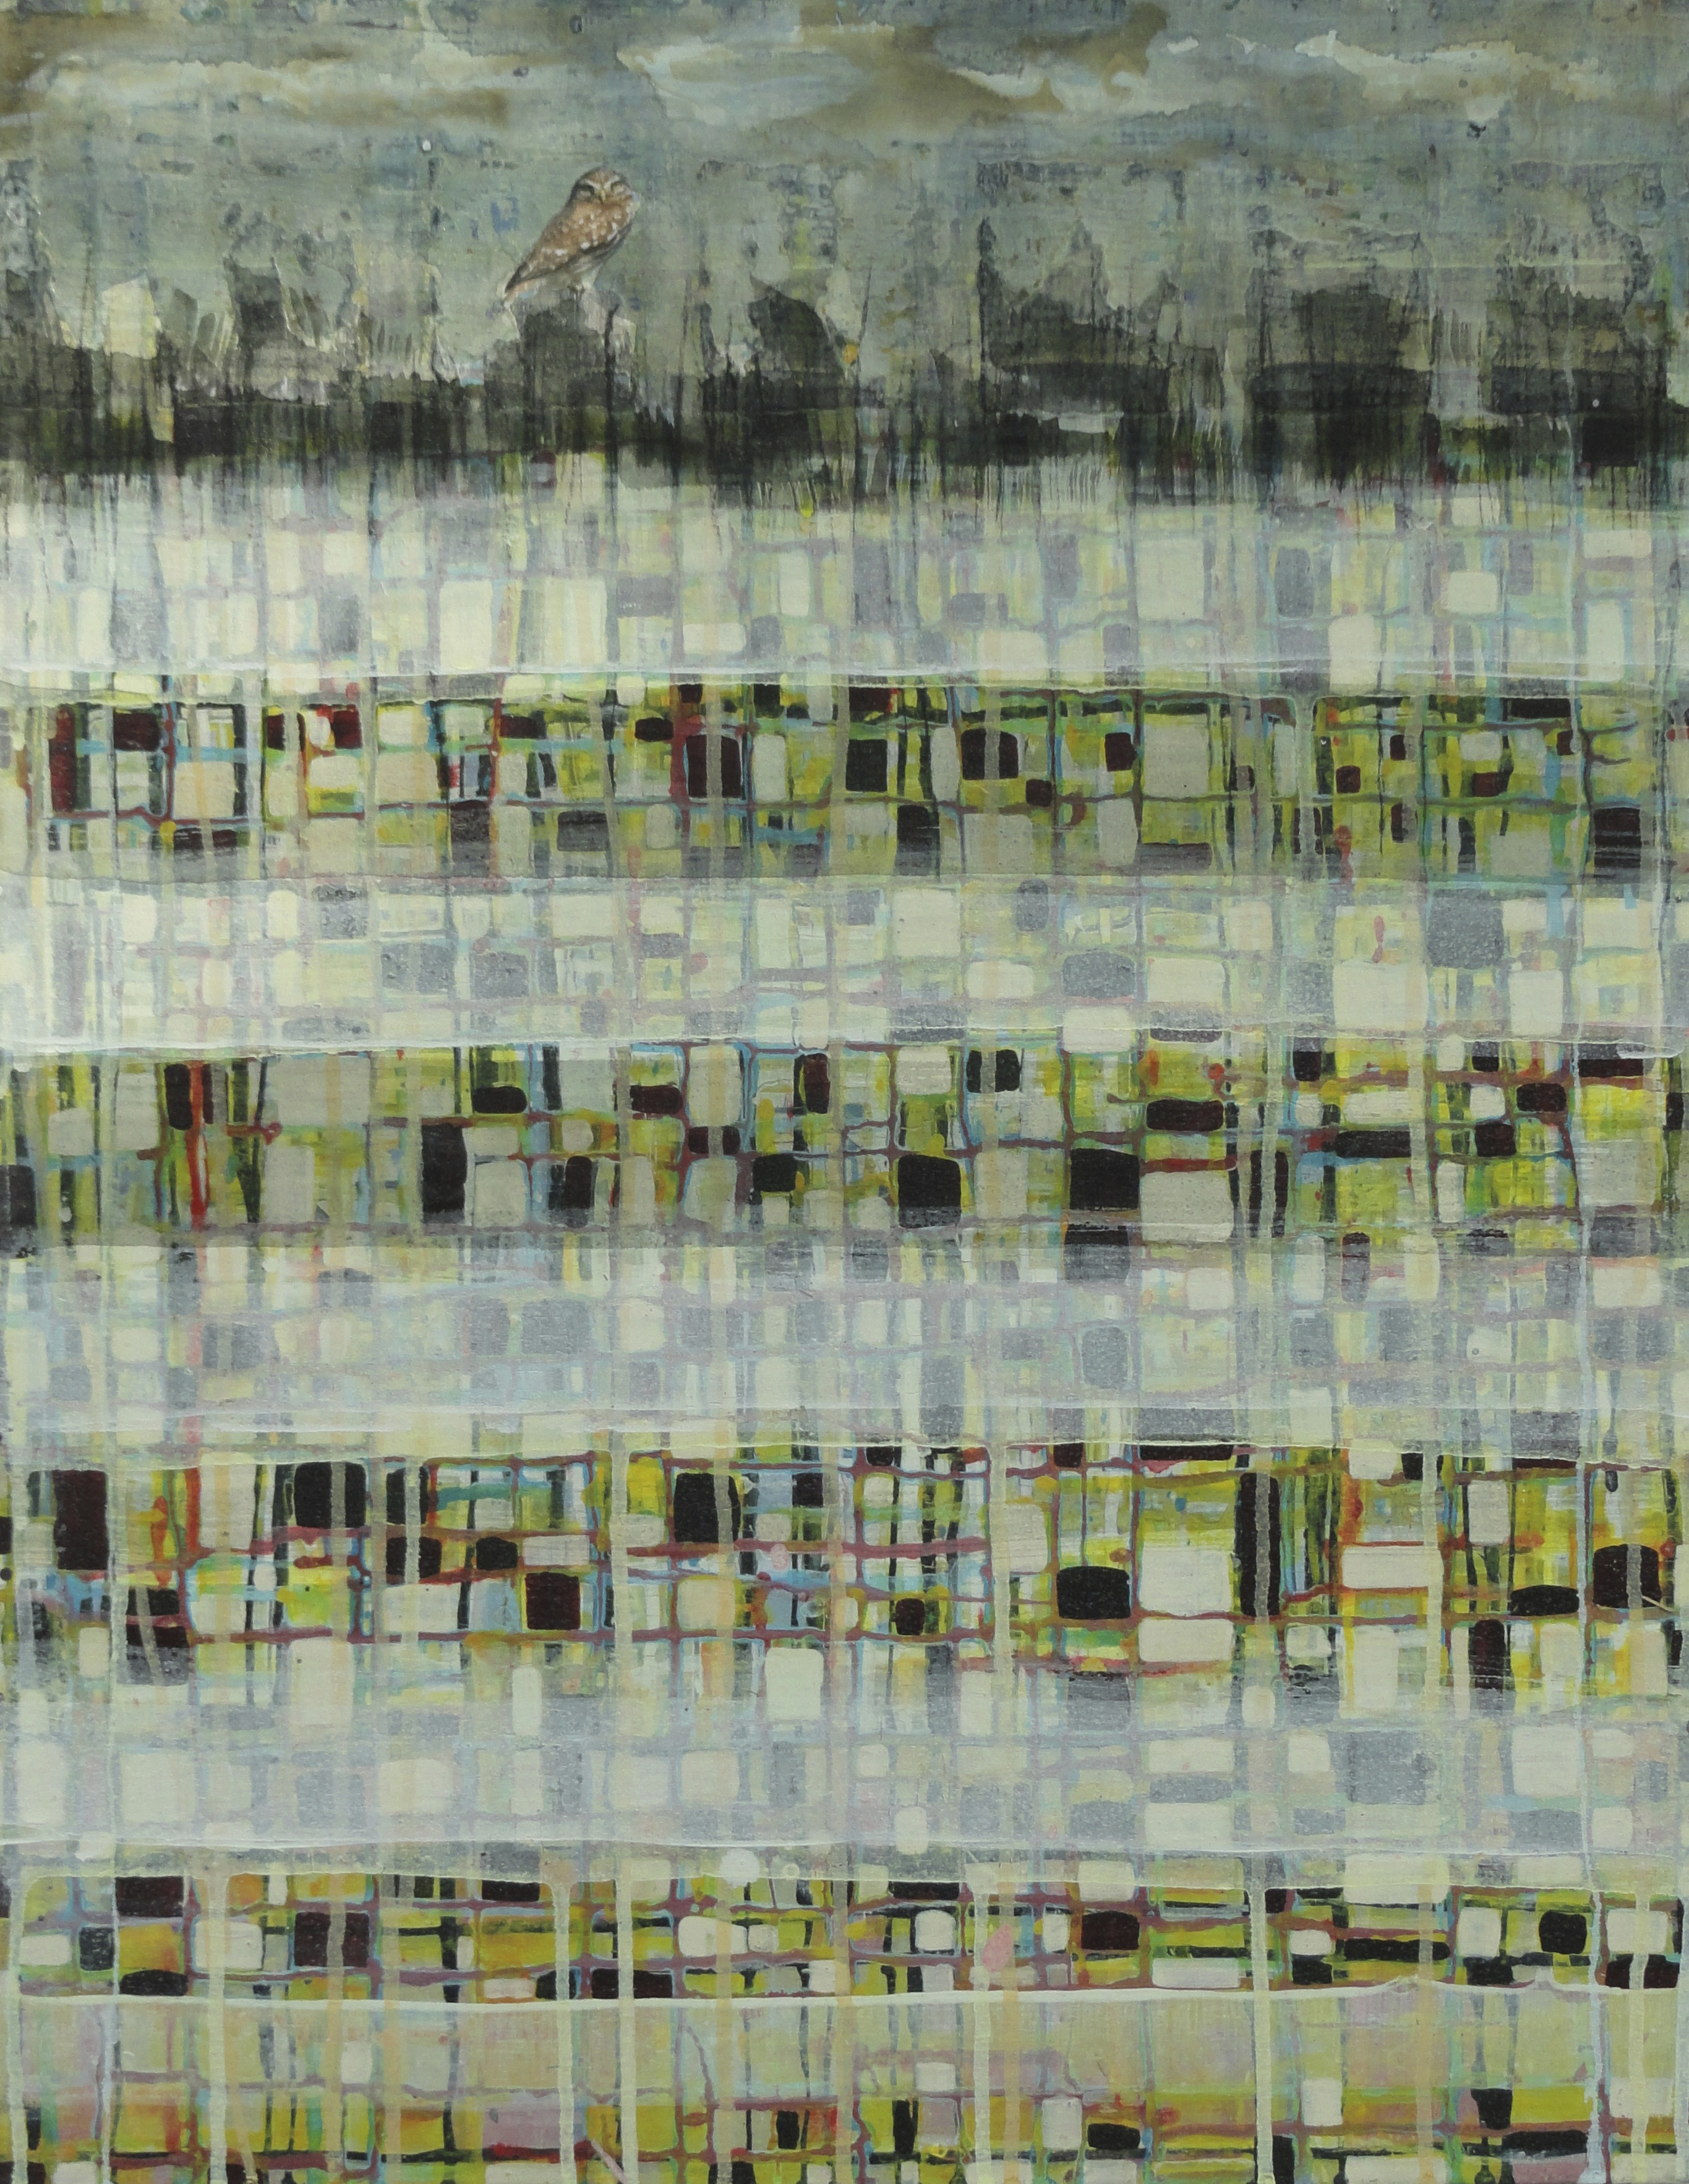
45 x 55 cm

Slide 27
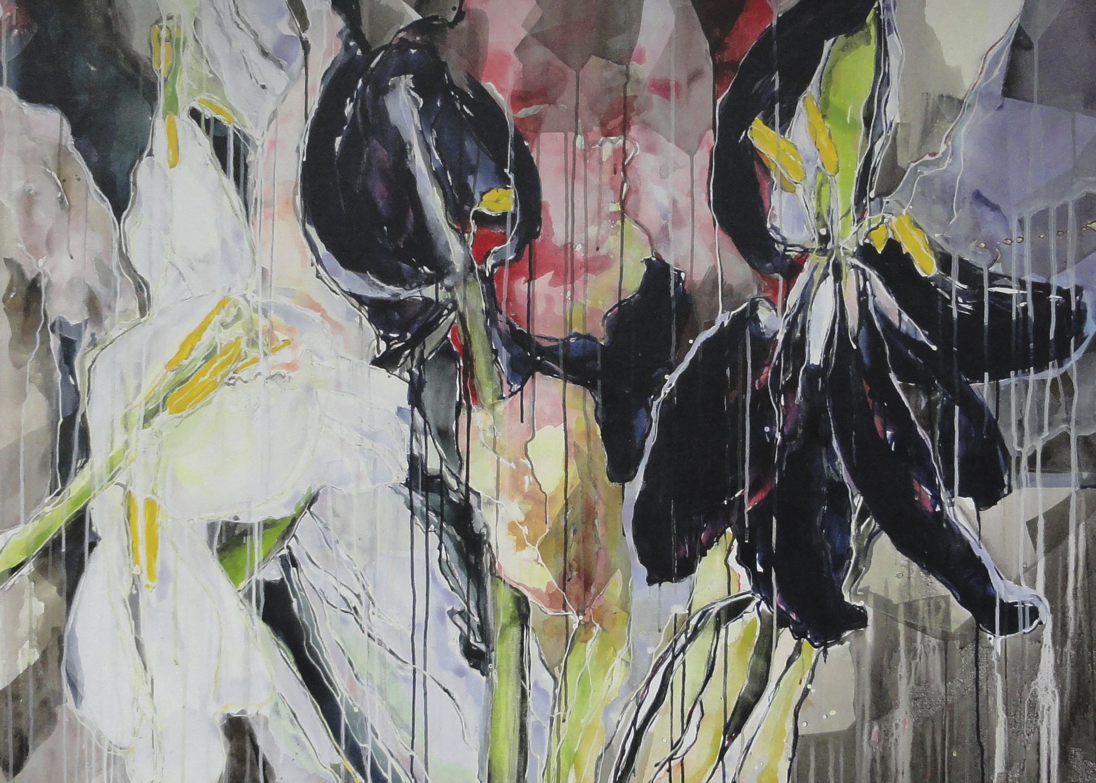
140 x 100 cm

Slide 28
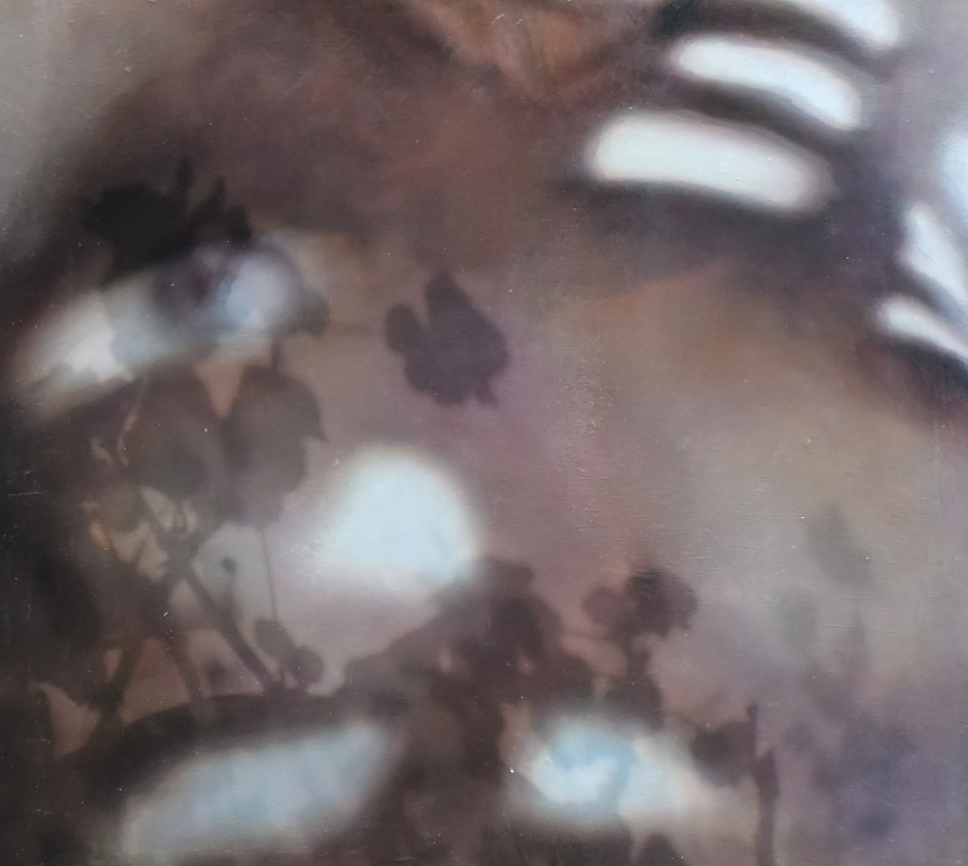
40 x 36 cm

Slide 29
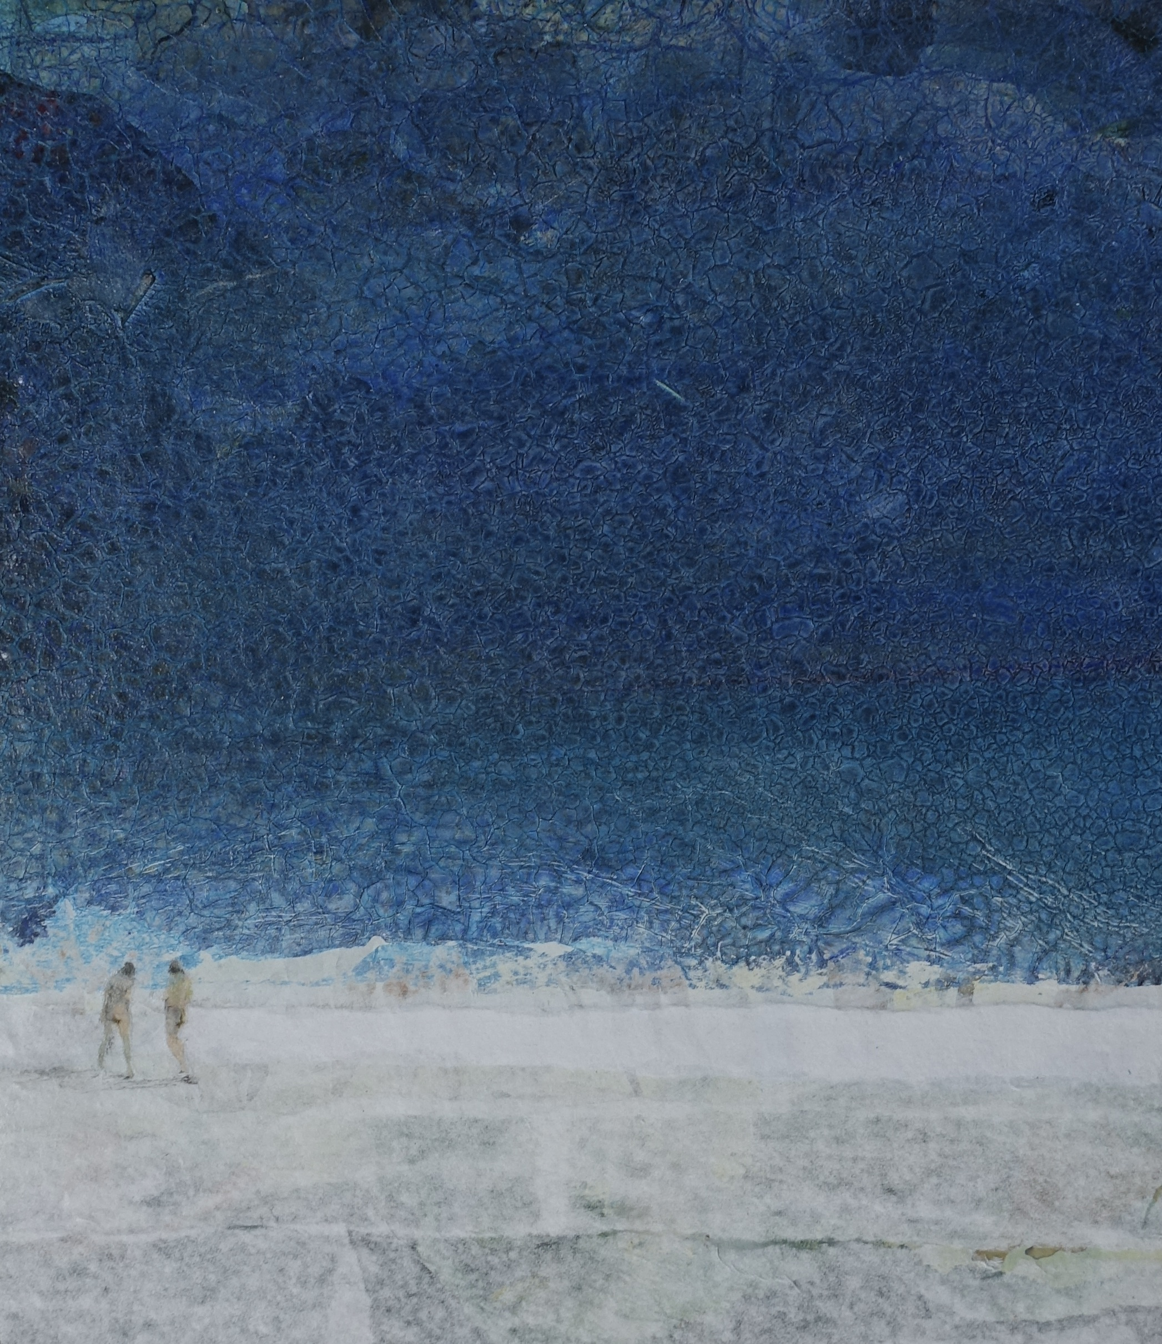
26 x 30 cm

Slide 30
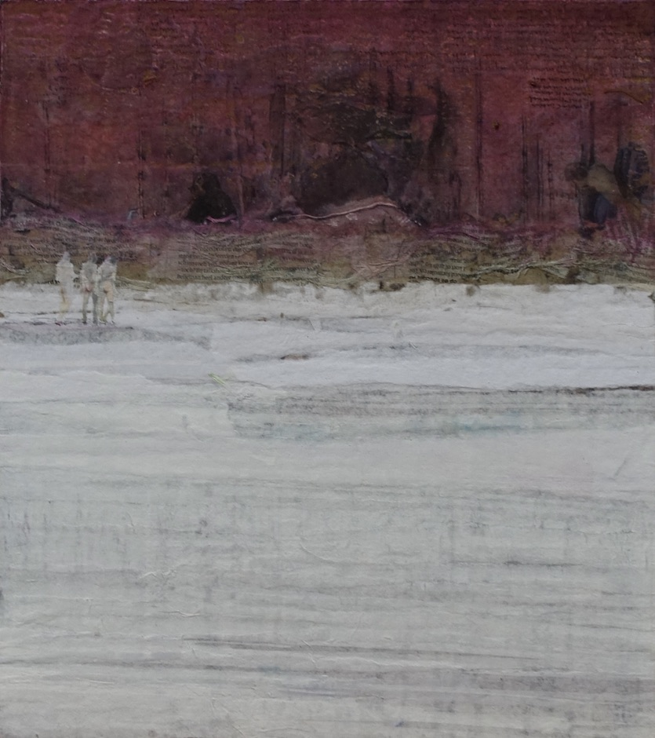
35 x 39 cm

Slide 31
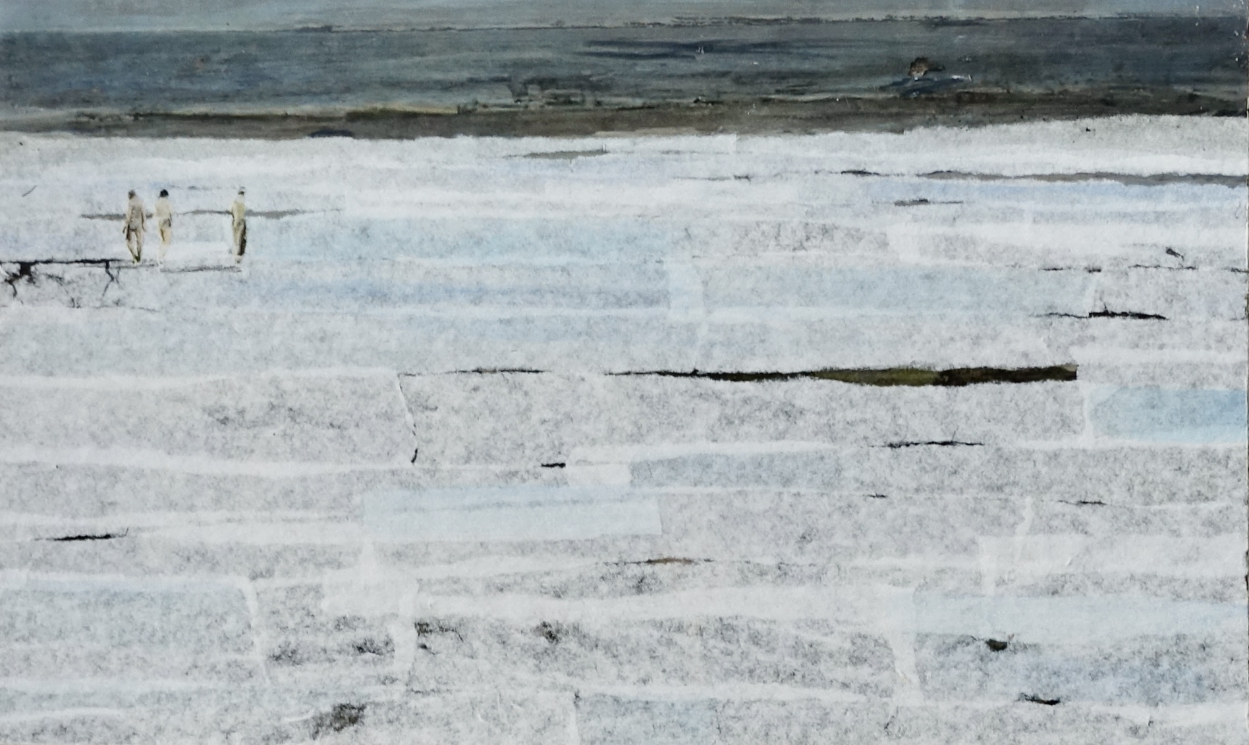
40 x 25 cm

Slide 32
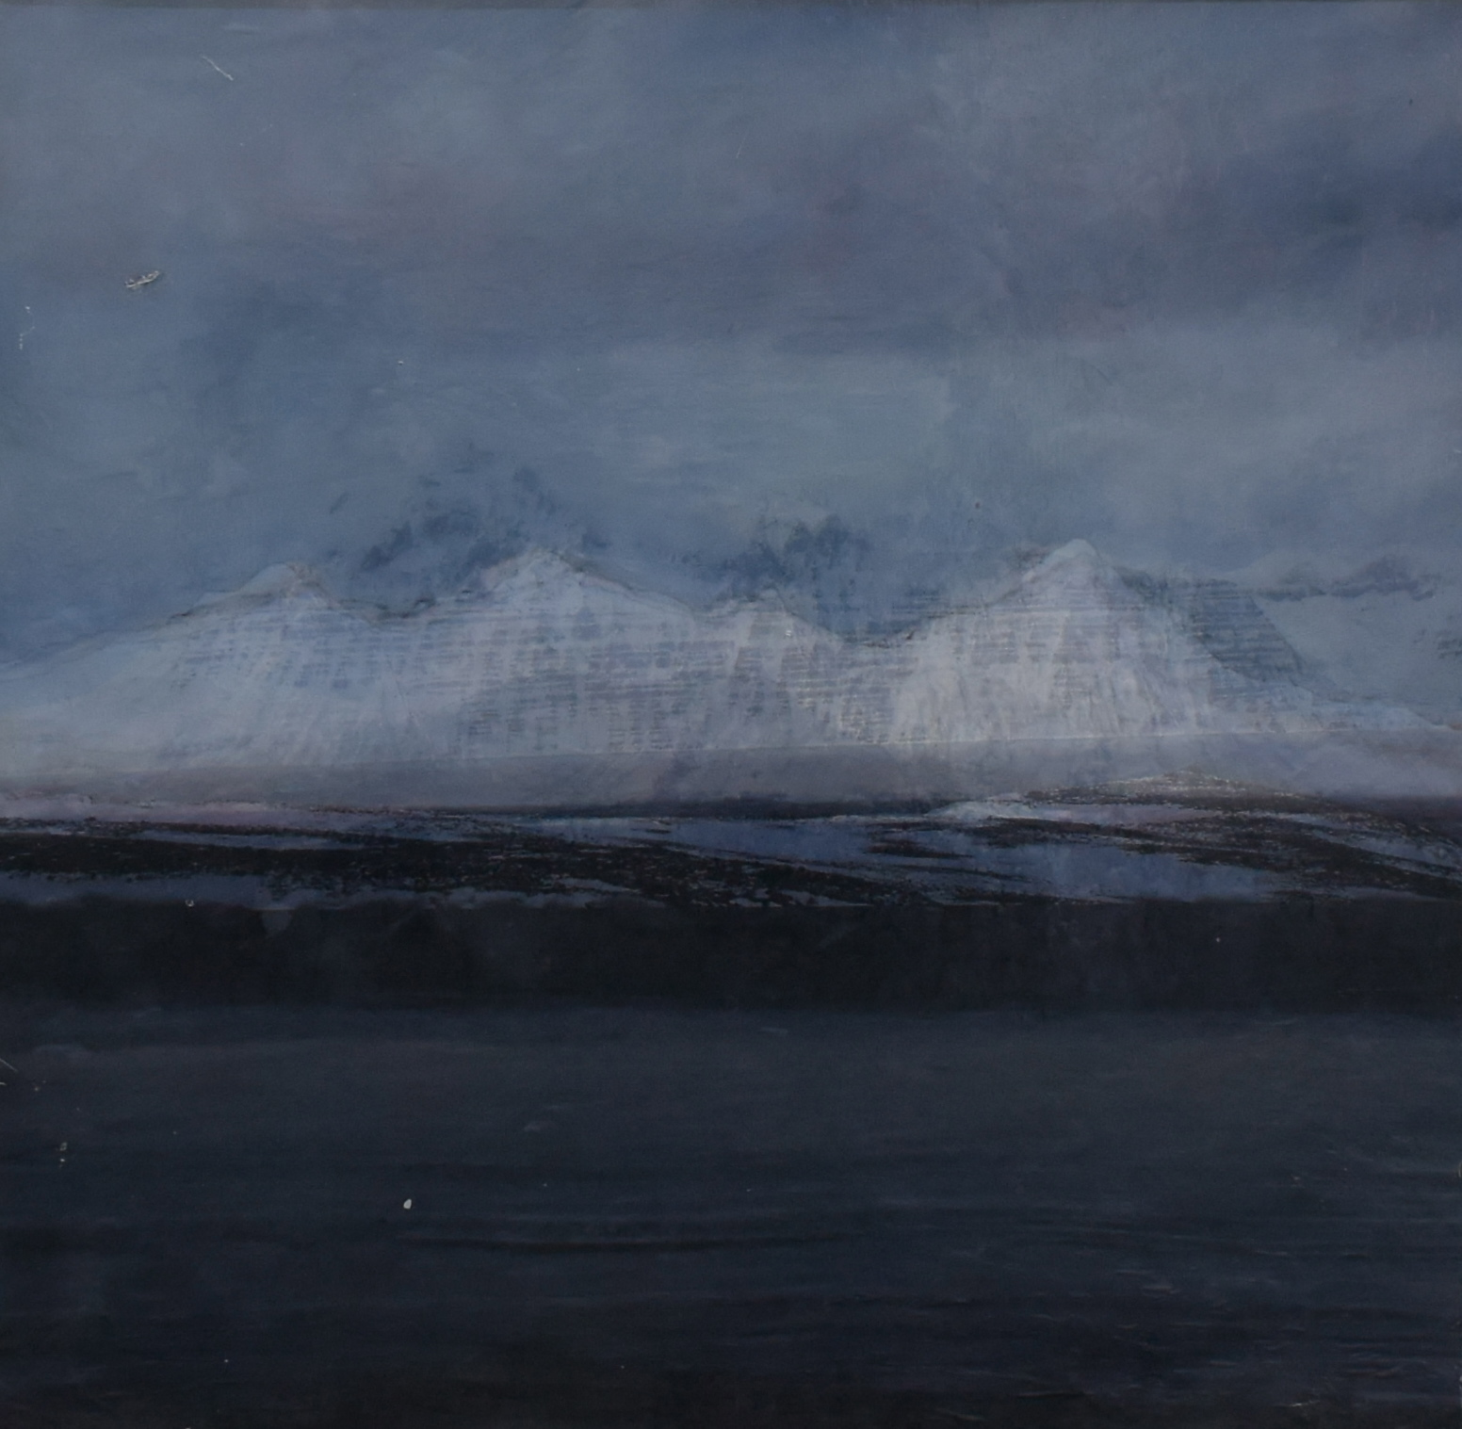
37 x 37 cm

Slide 33
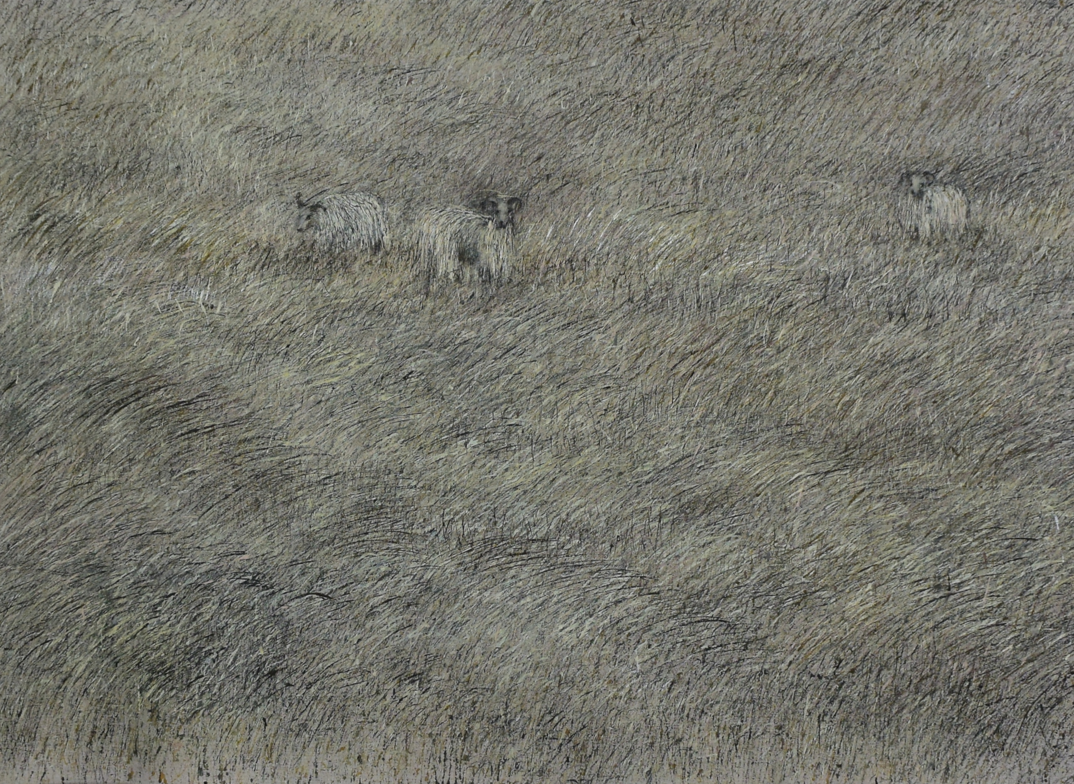
135 x 110 cm

Slide 34
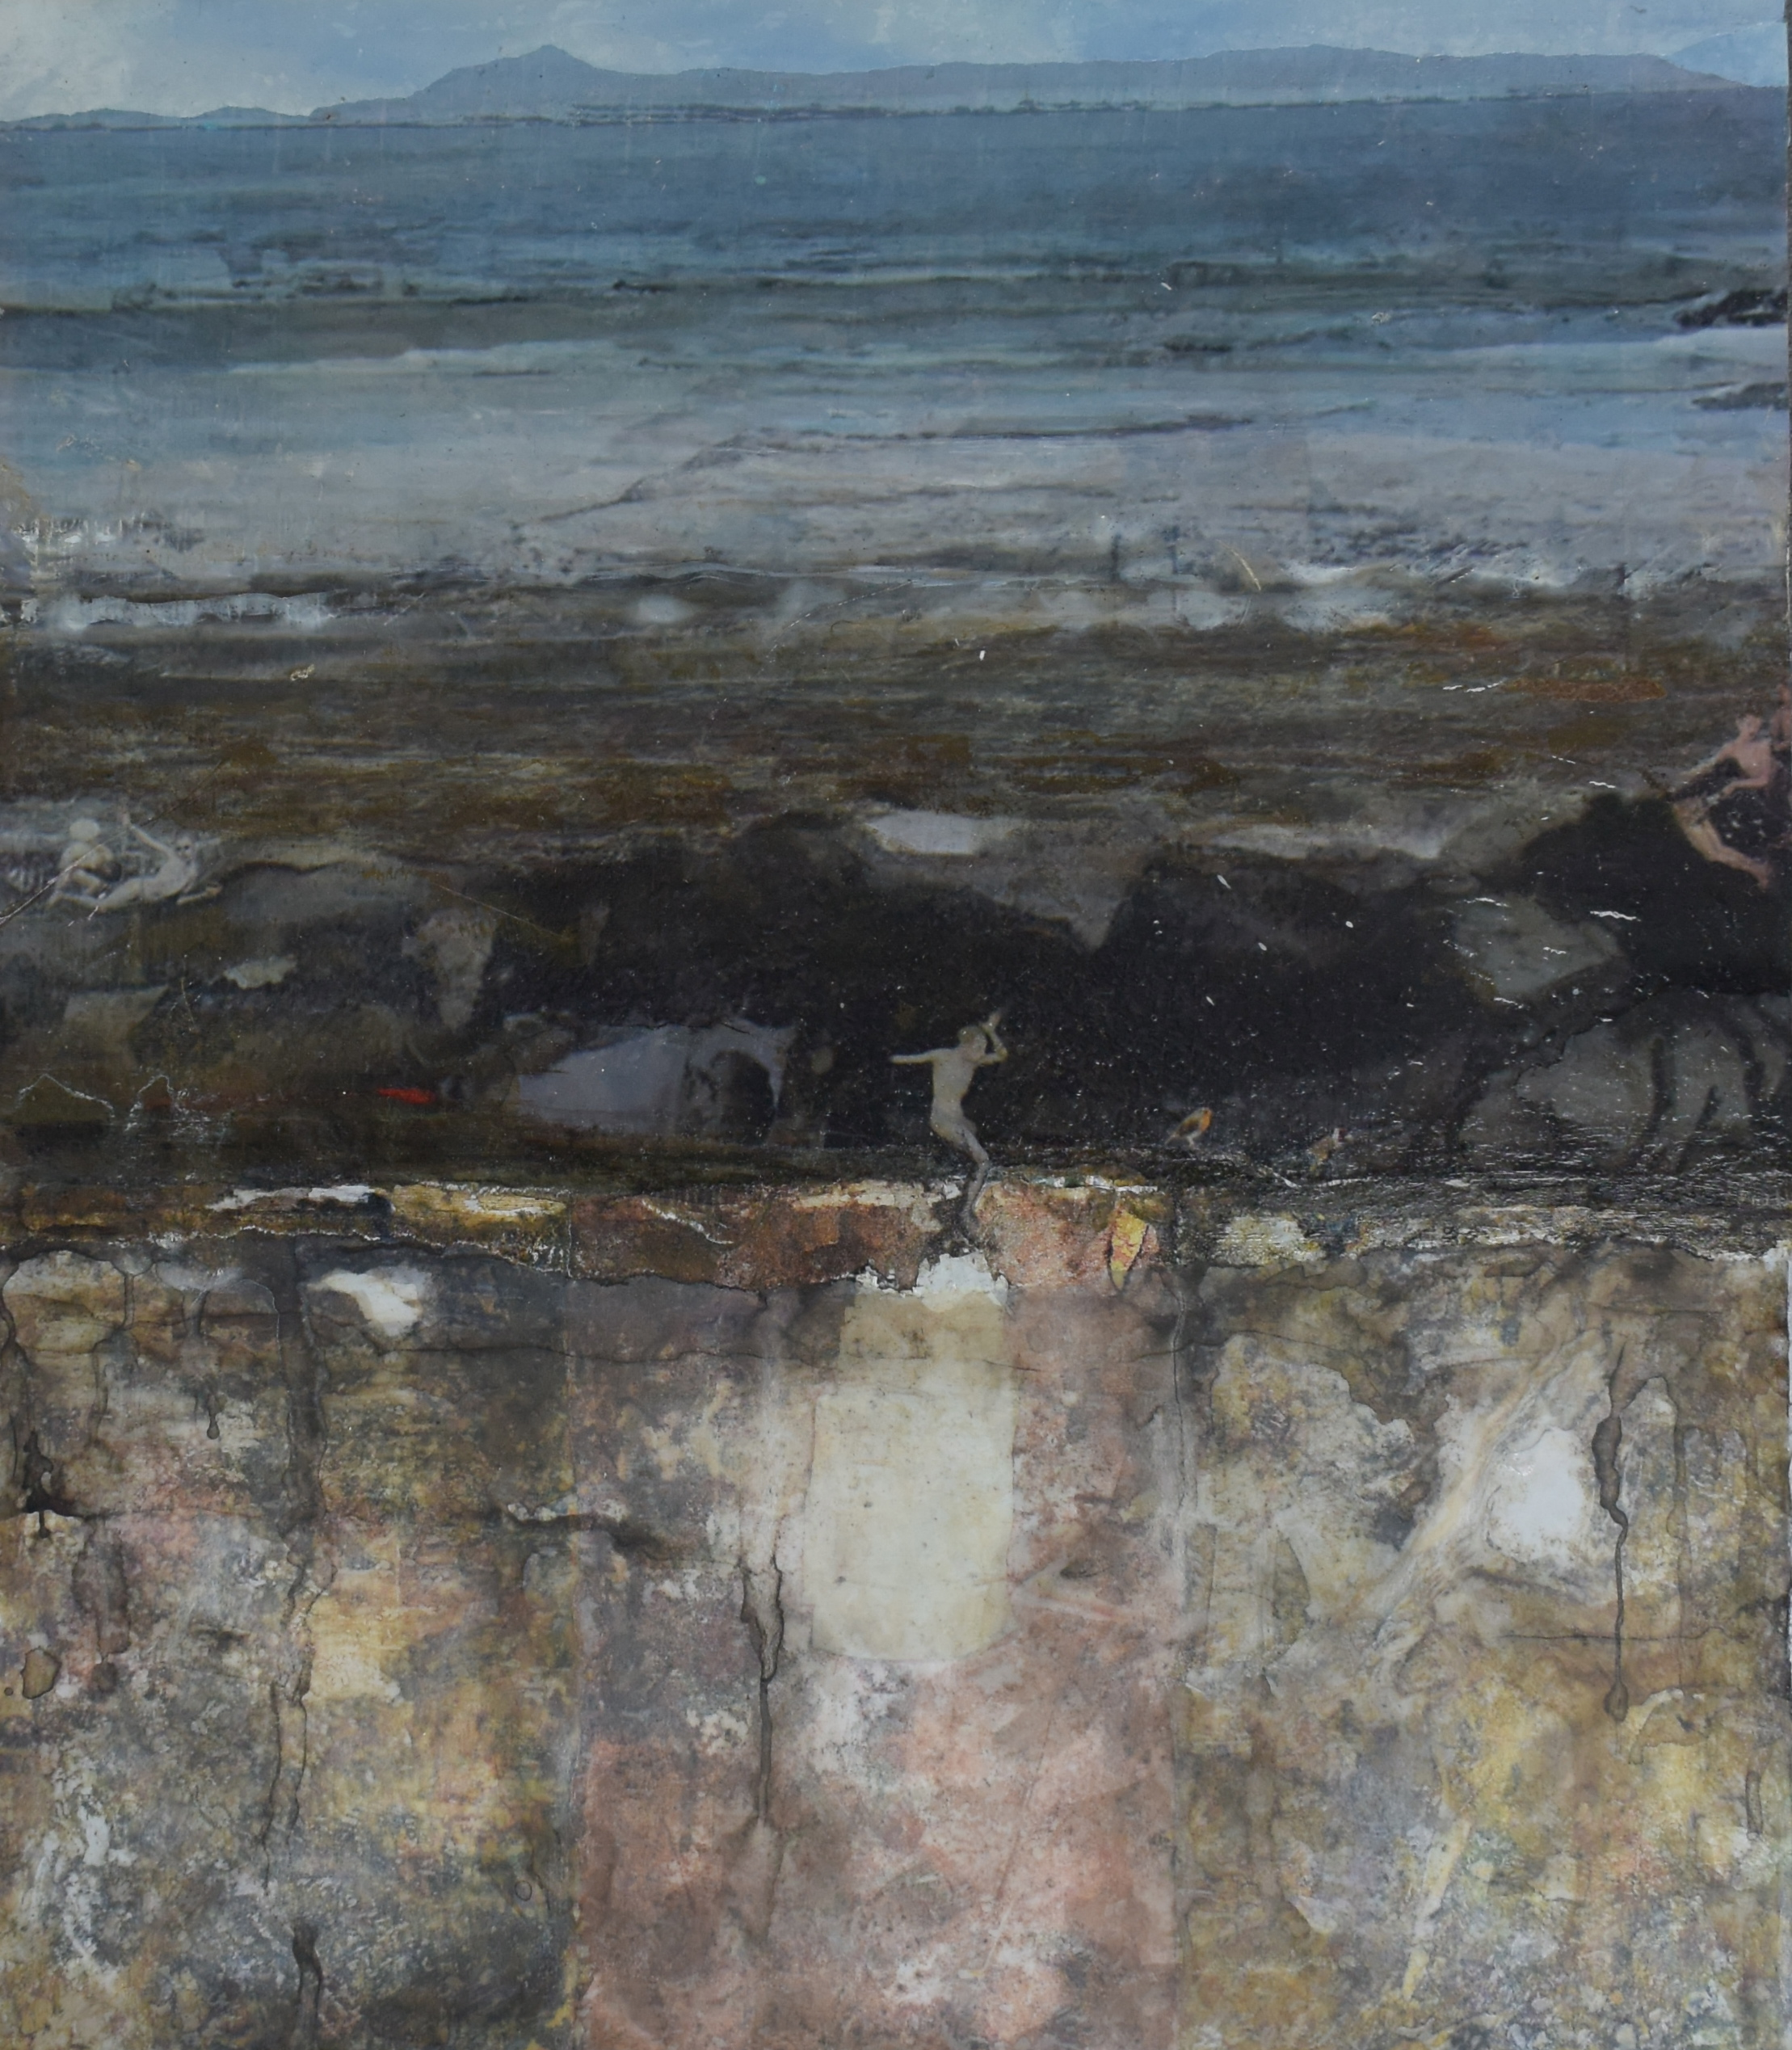
26 x 30 cm

Slide 35
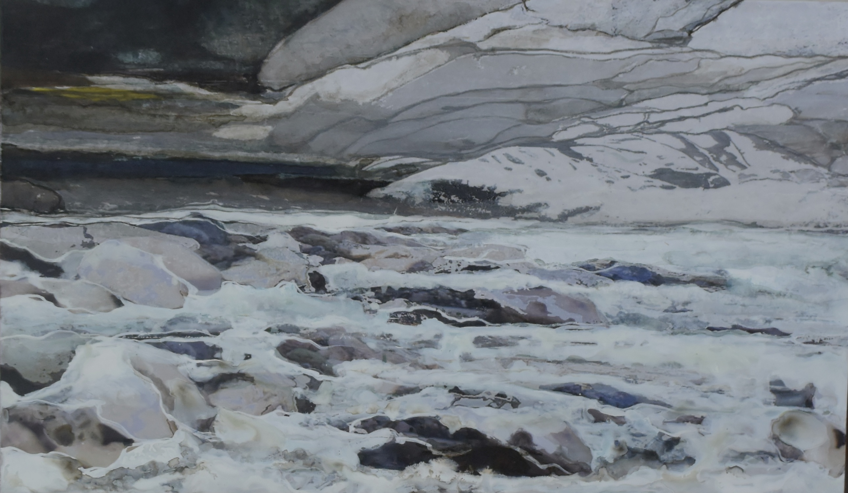
50 x 30 cm

Slide 36
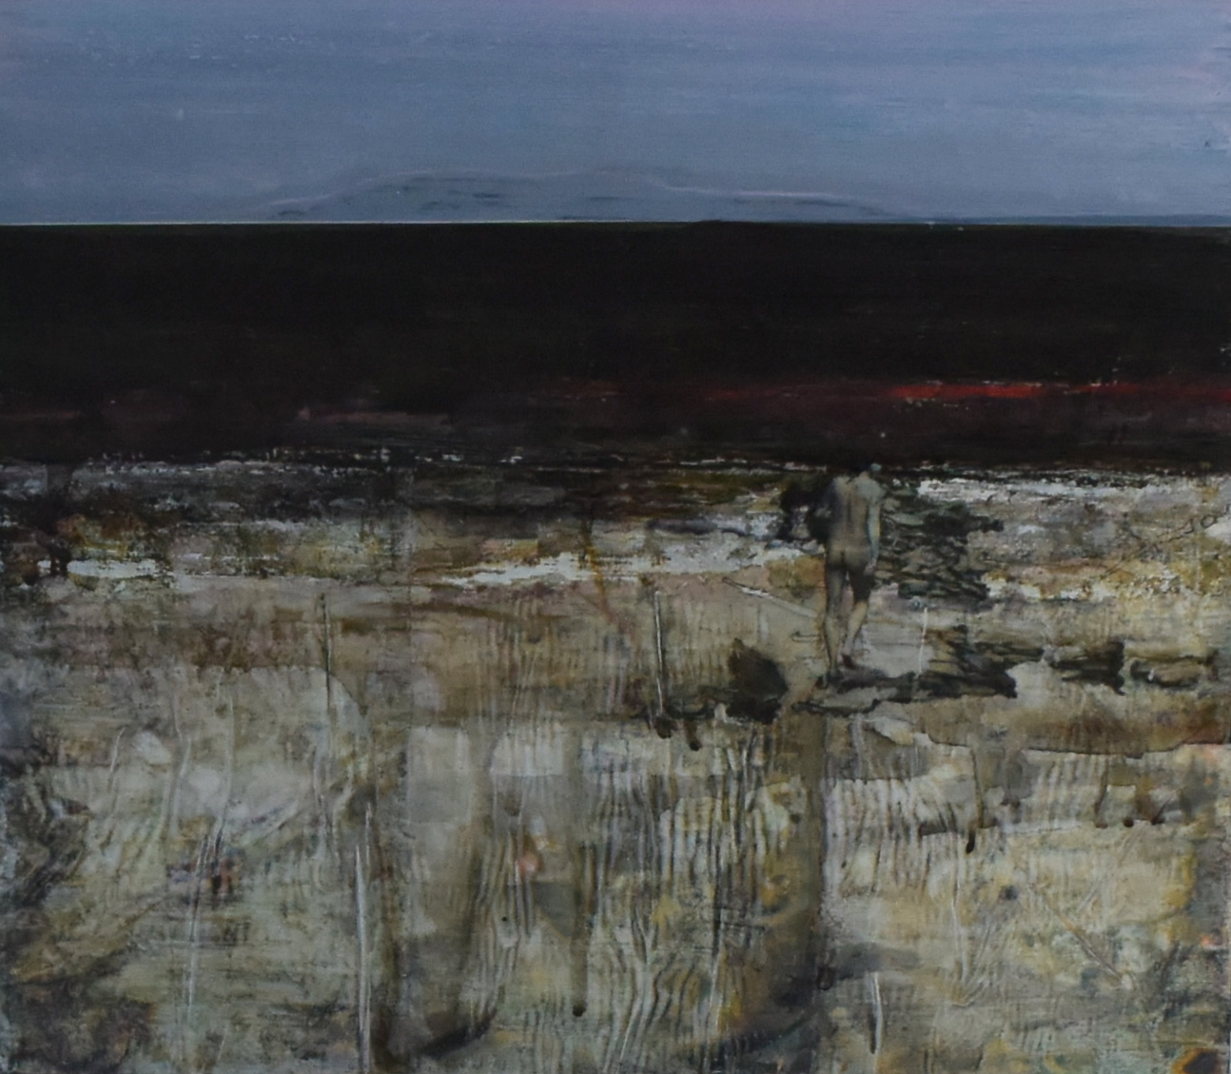
30 x 26 cm

Slide 37
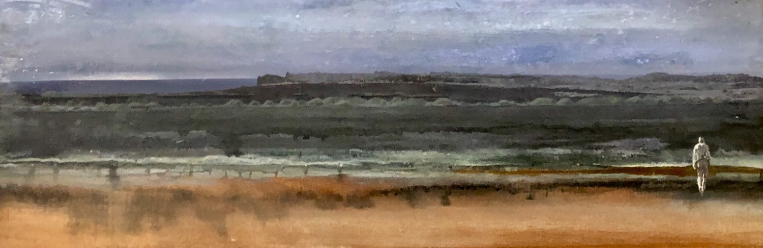
75 x 24 cm

Slide 38
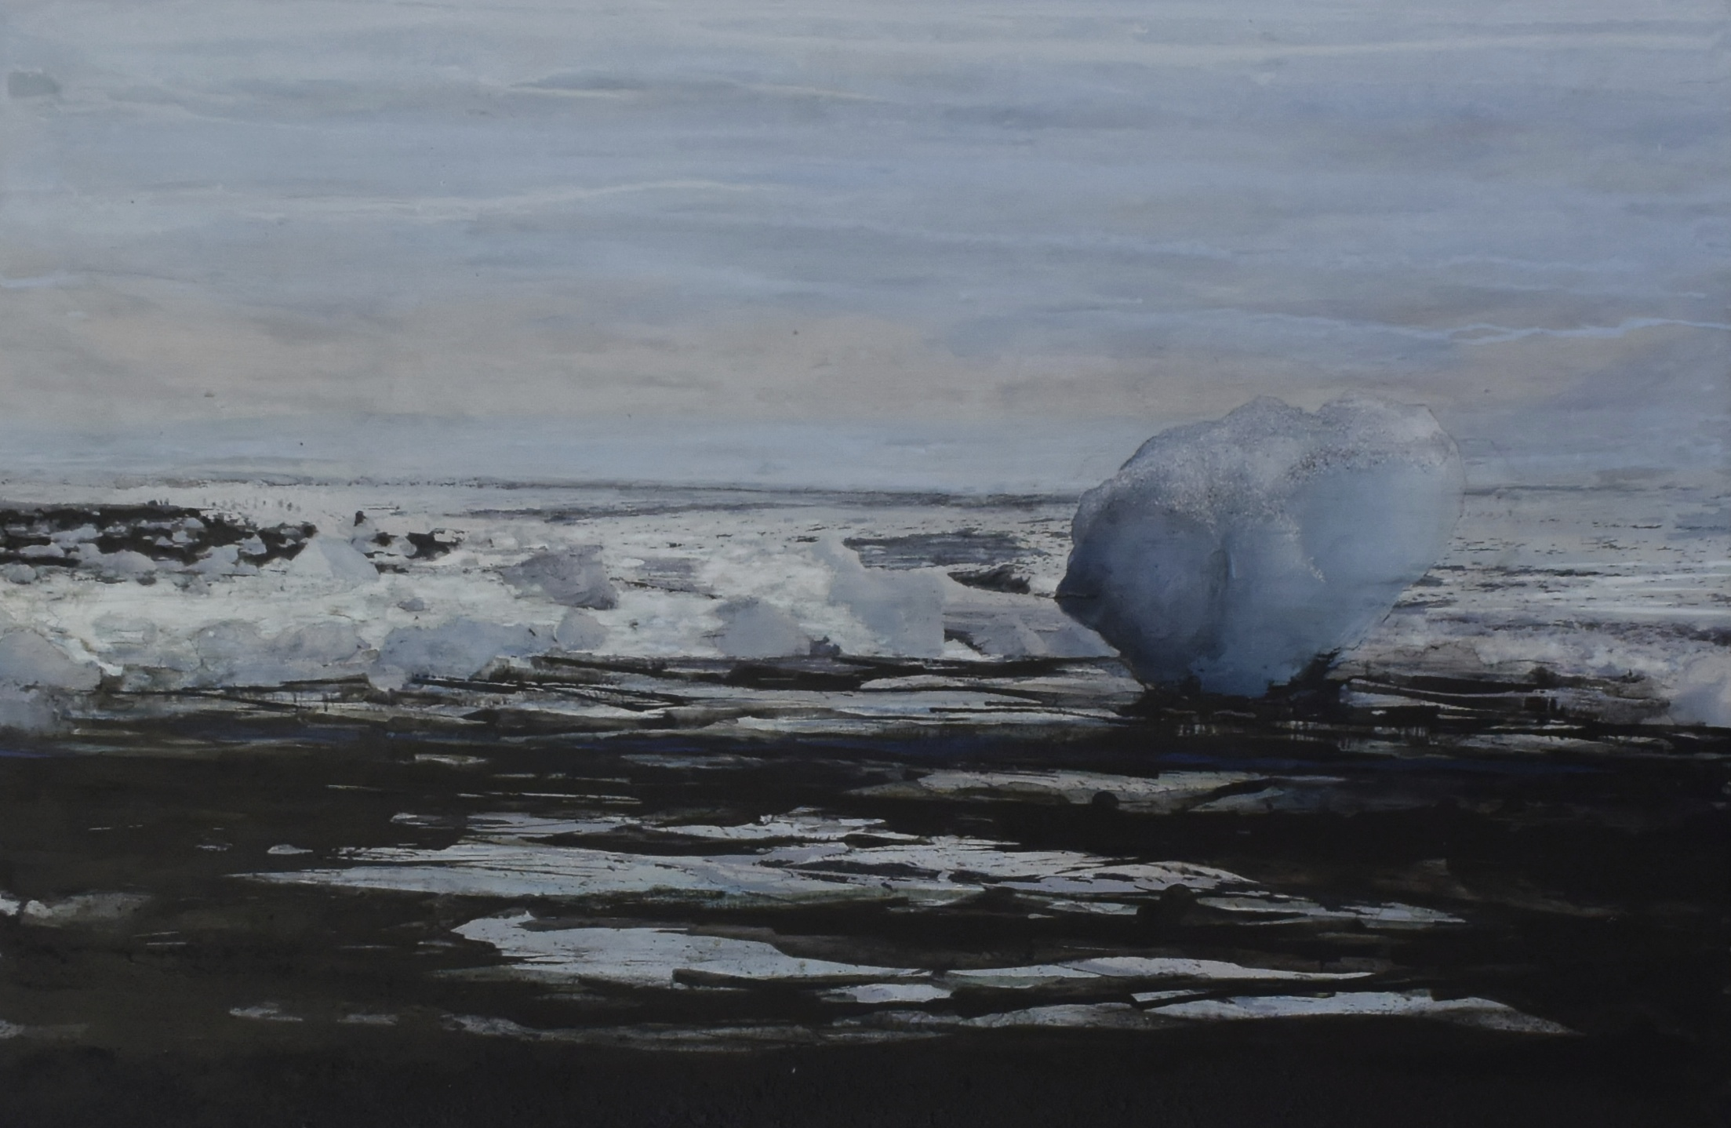
75 x 50 cm

Slide 39
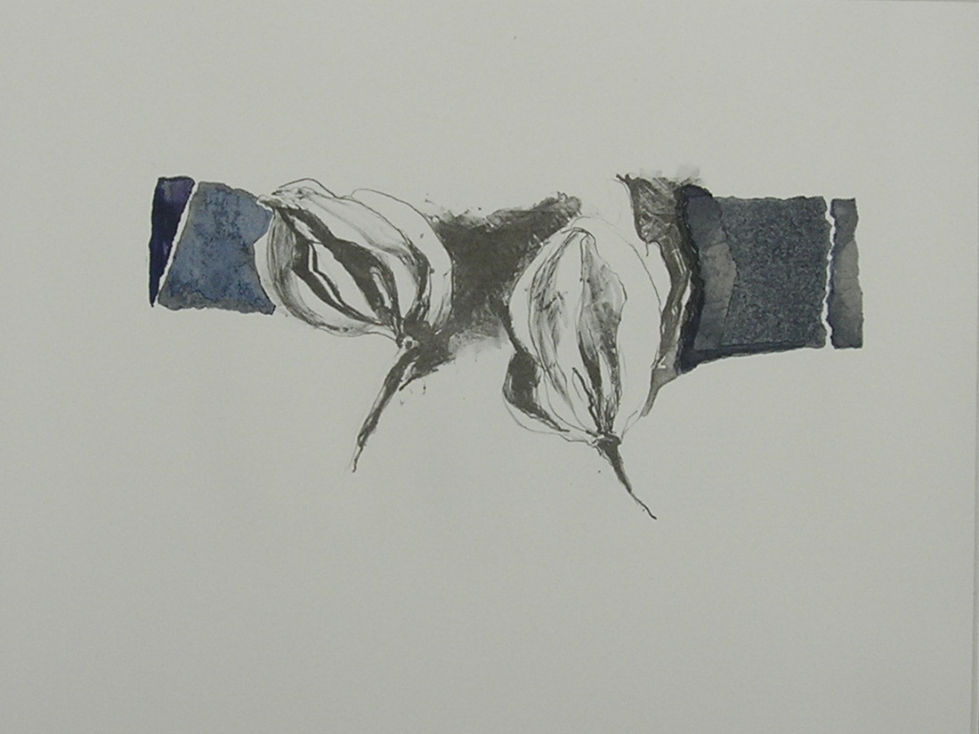
65 x 50 cm

Slide 40
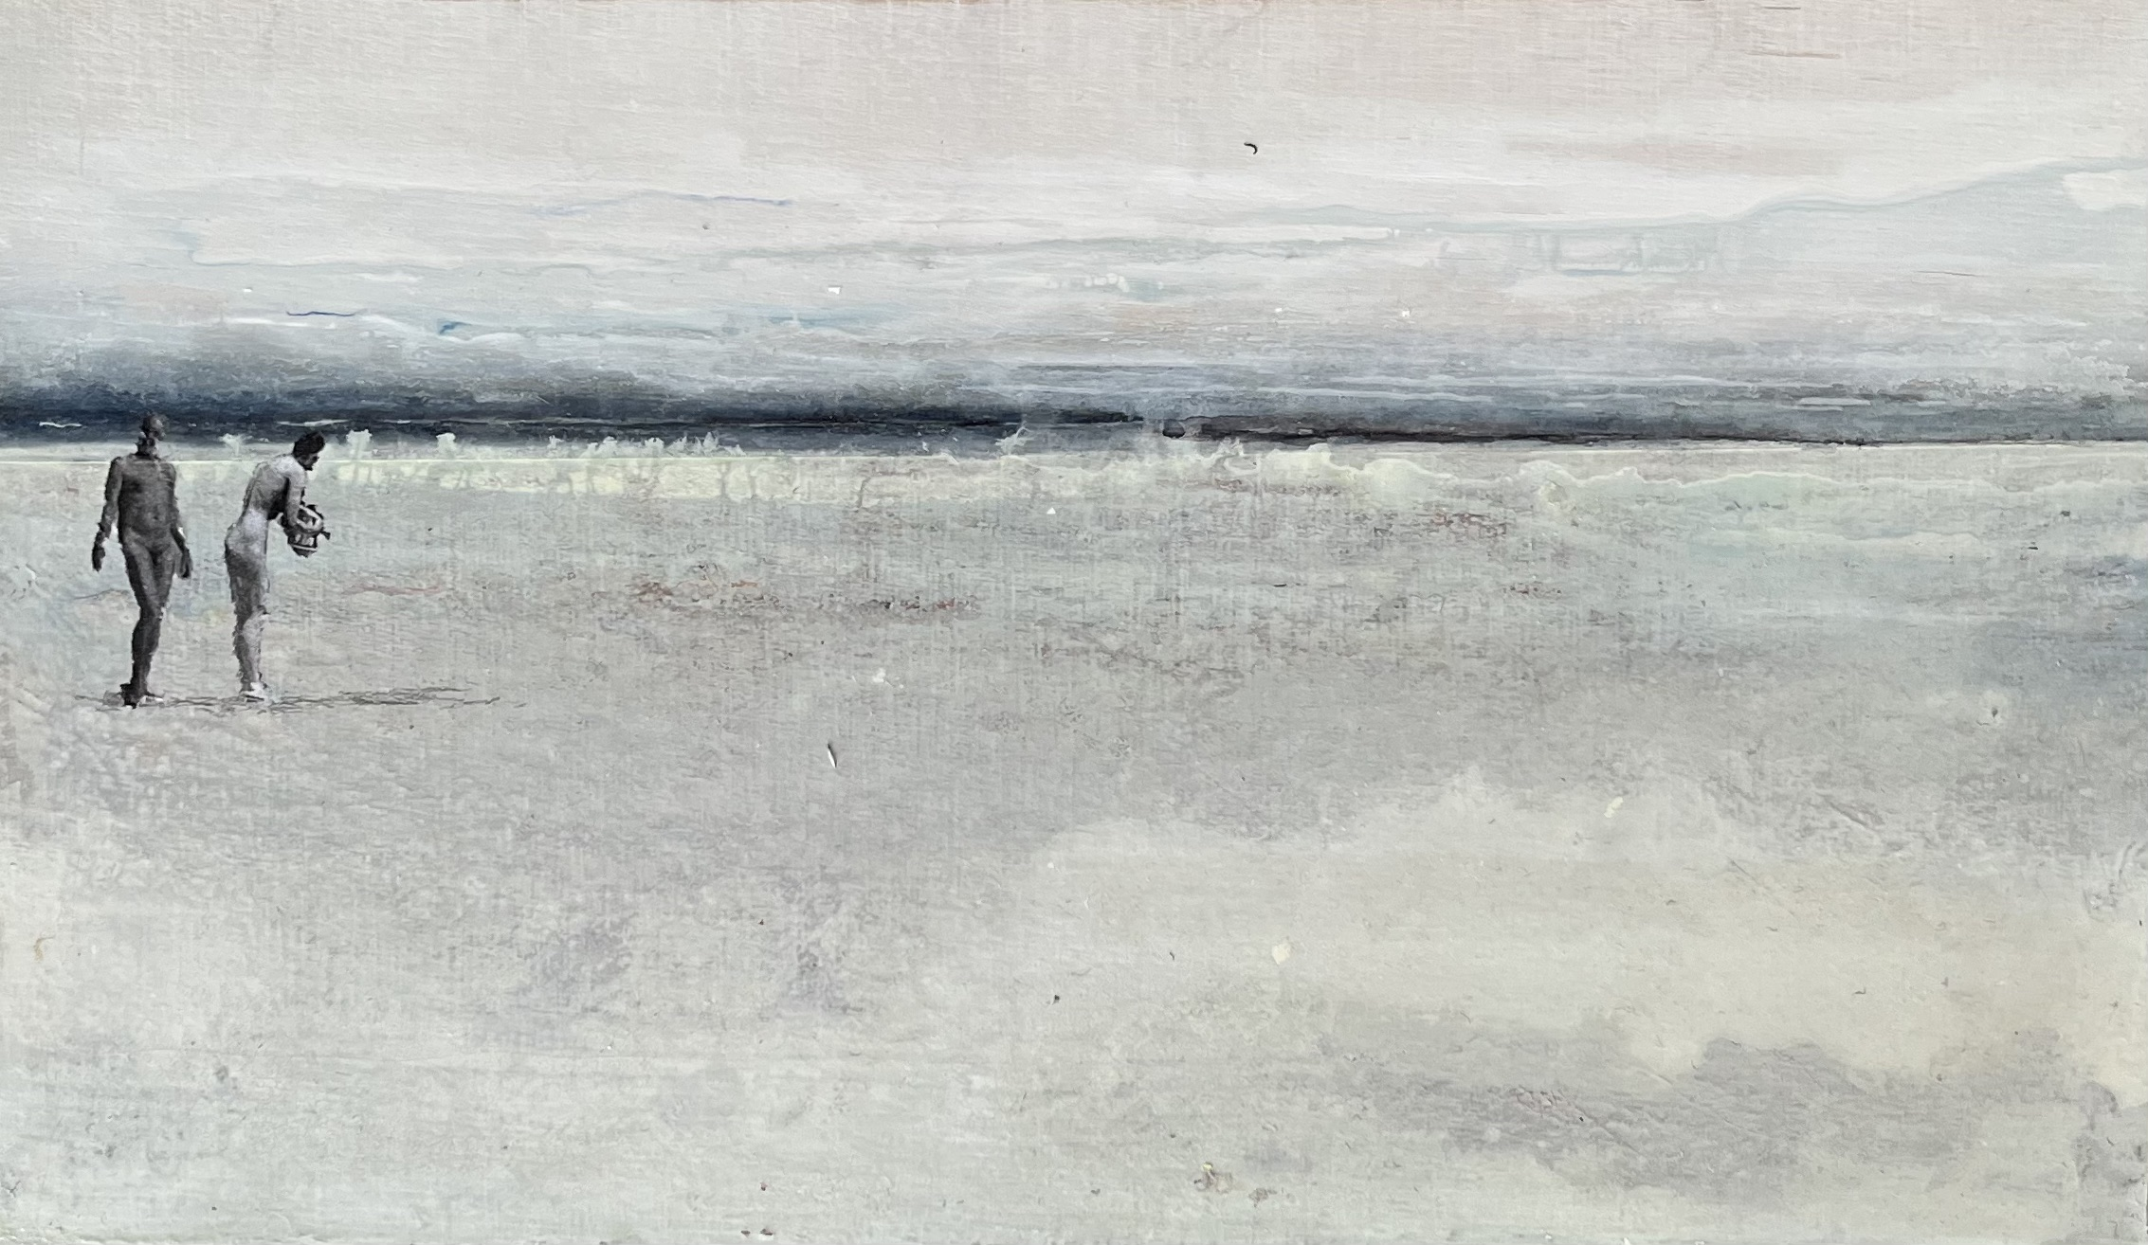
30 x 20 cm

Slide 41
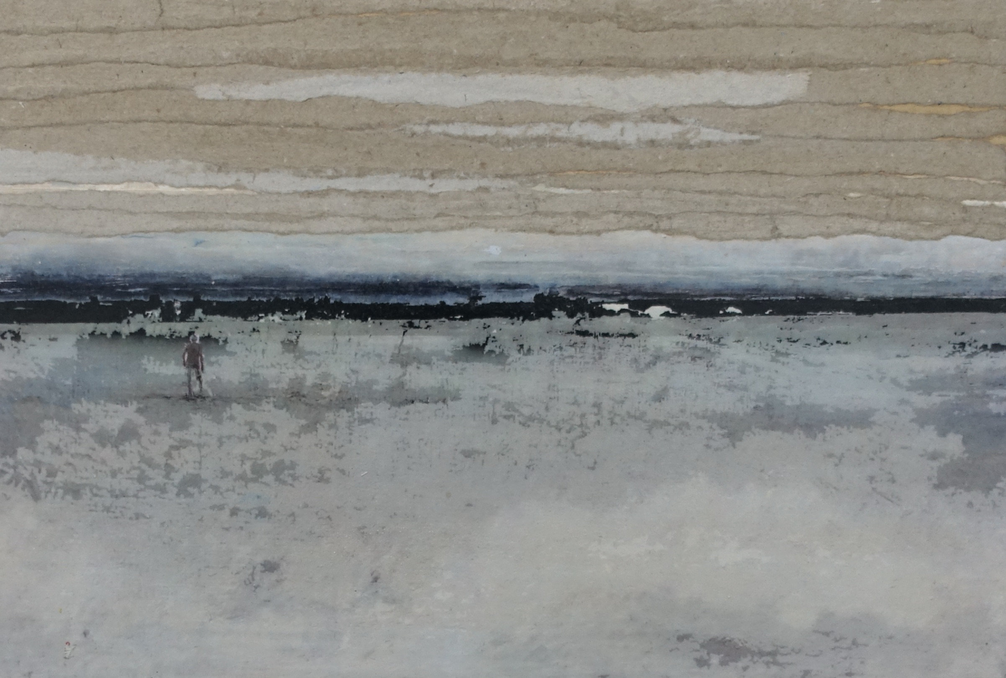
30 x 20 cm

Slide 42
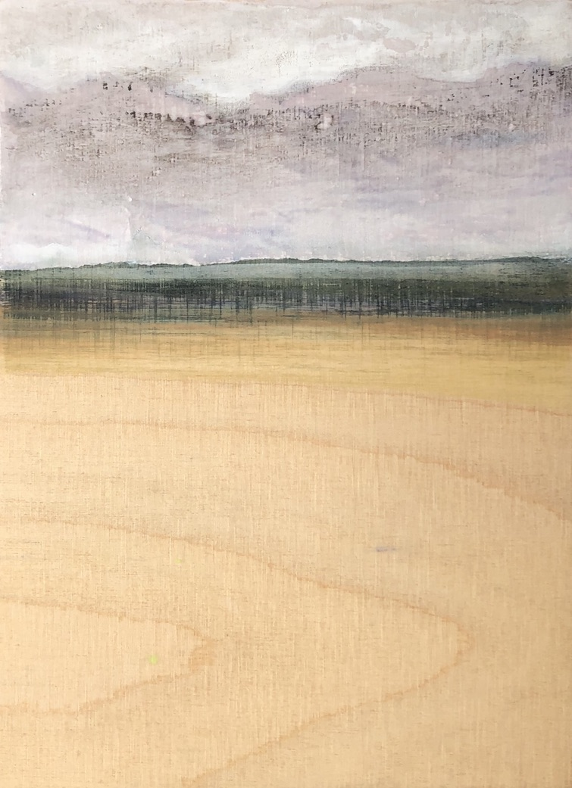
15 x 21 cm

Slide 43
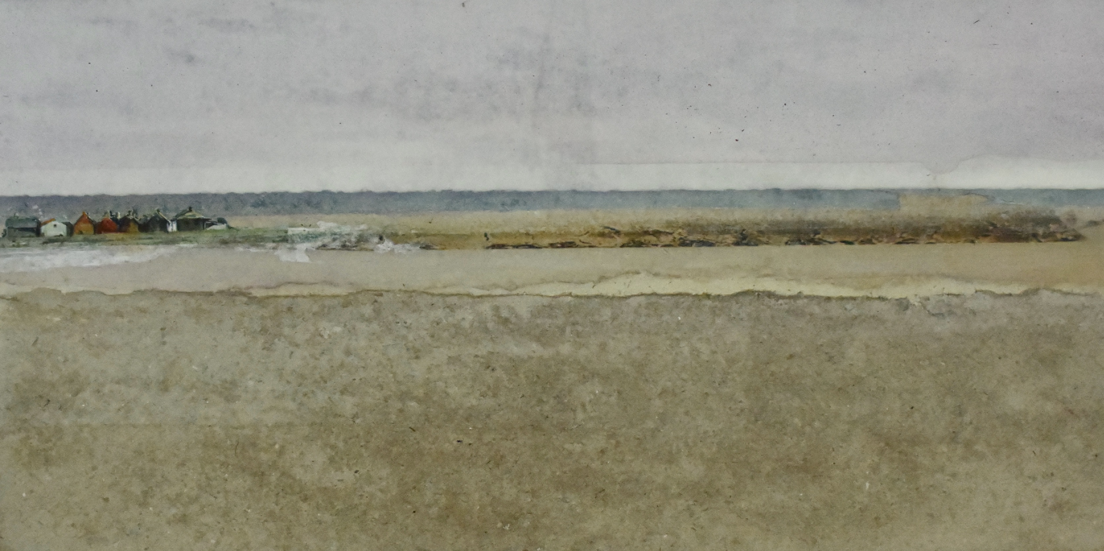
29 x 15 cm

Slide 44
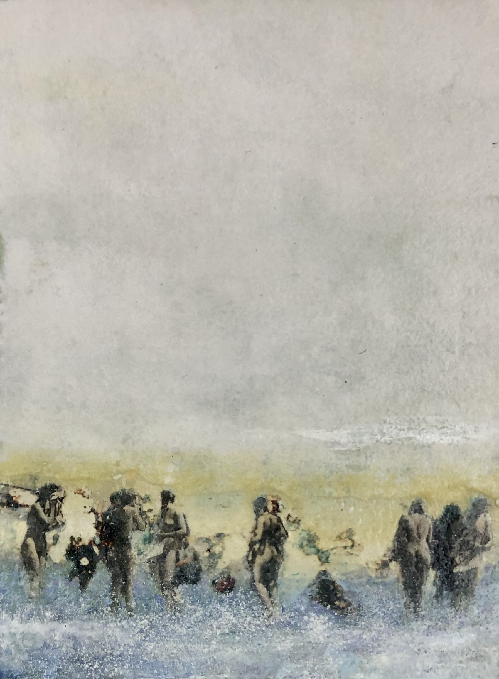
15 x 20 cm

Slide 45
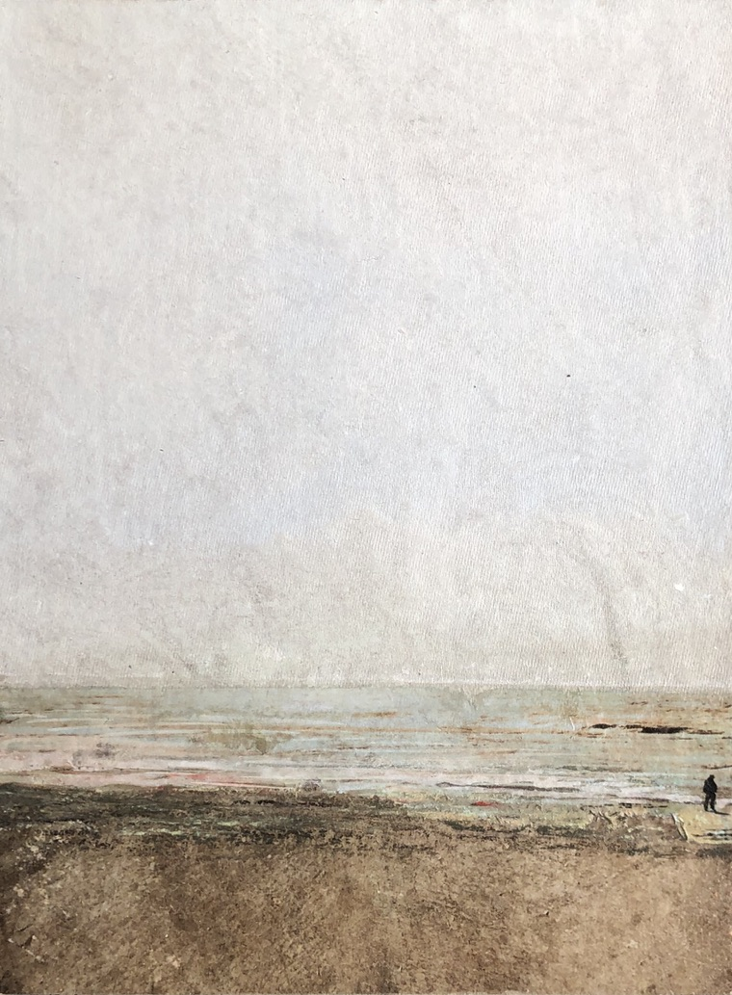
14 x 20 cm

Slide 46
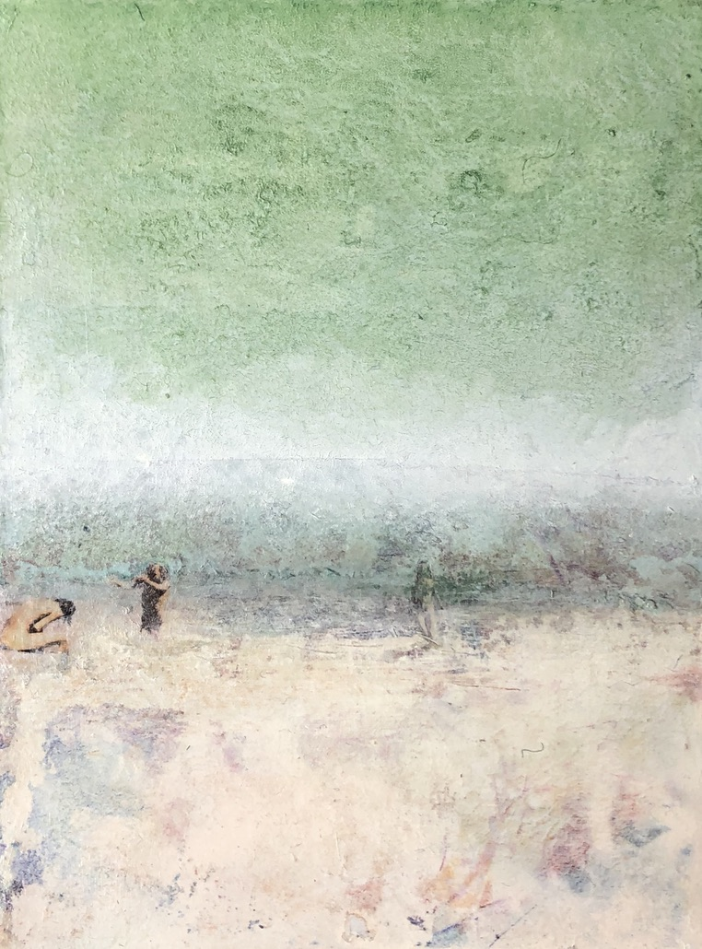
15 x 20 cm

Slide 47
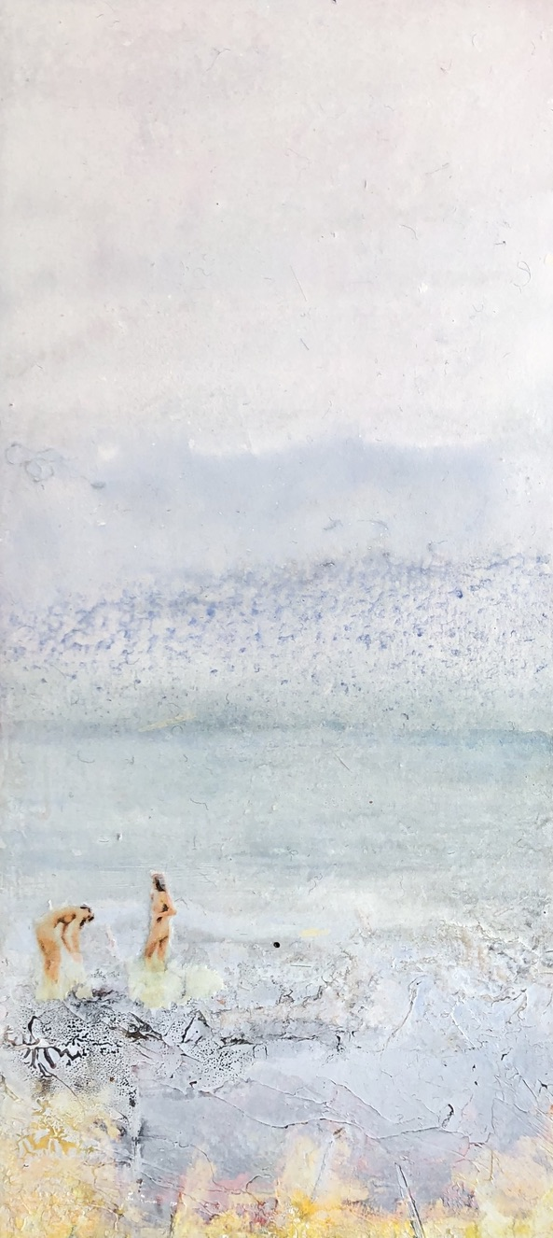
15 x 30 cm

Slide 48
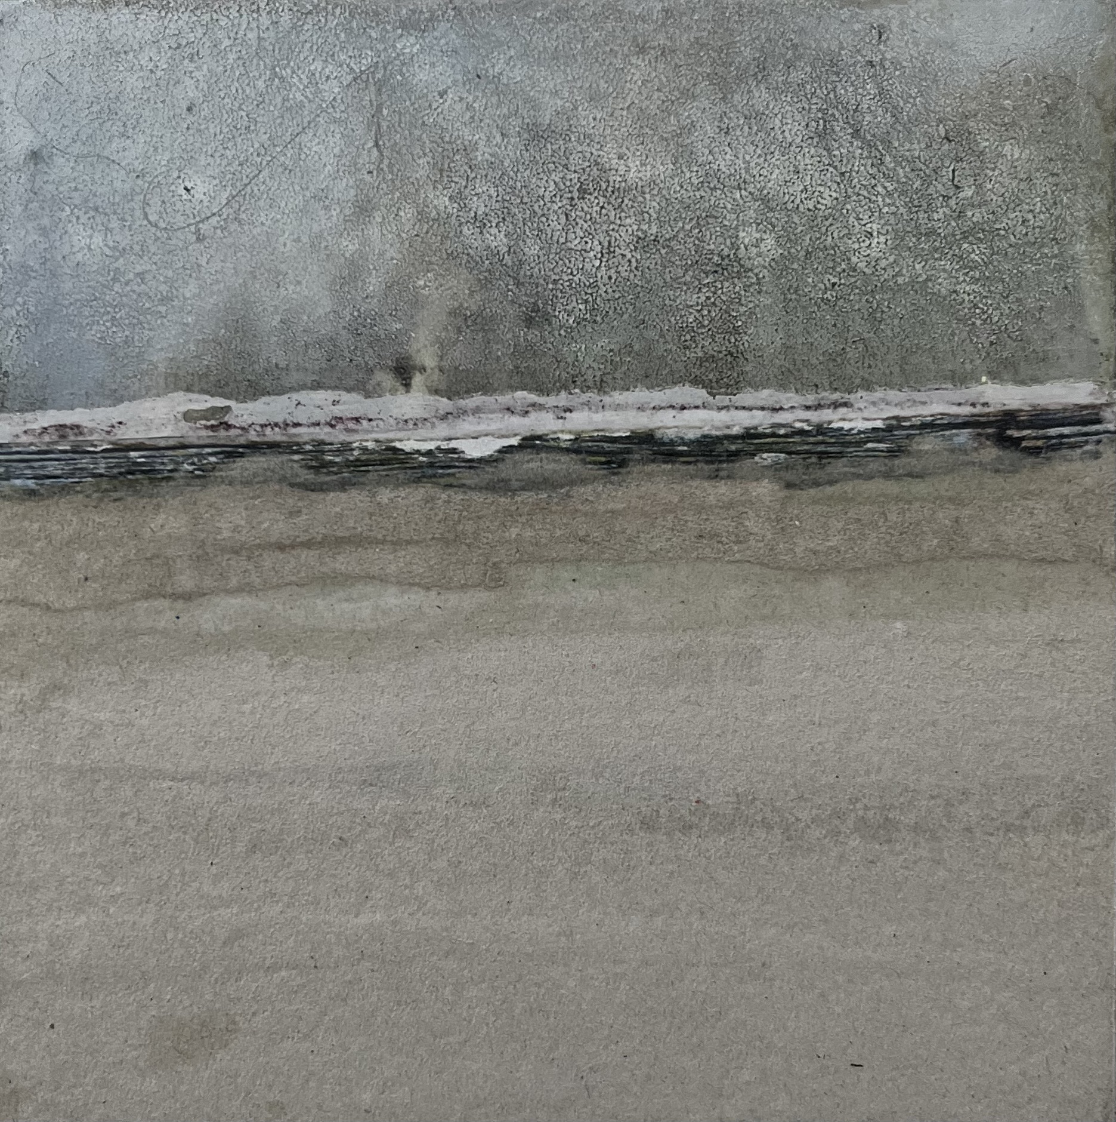
15 x 15 cm

Slide 49
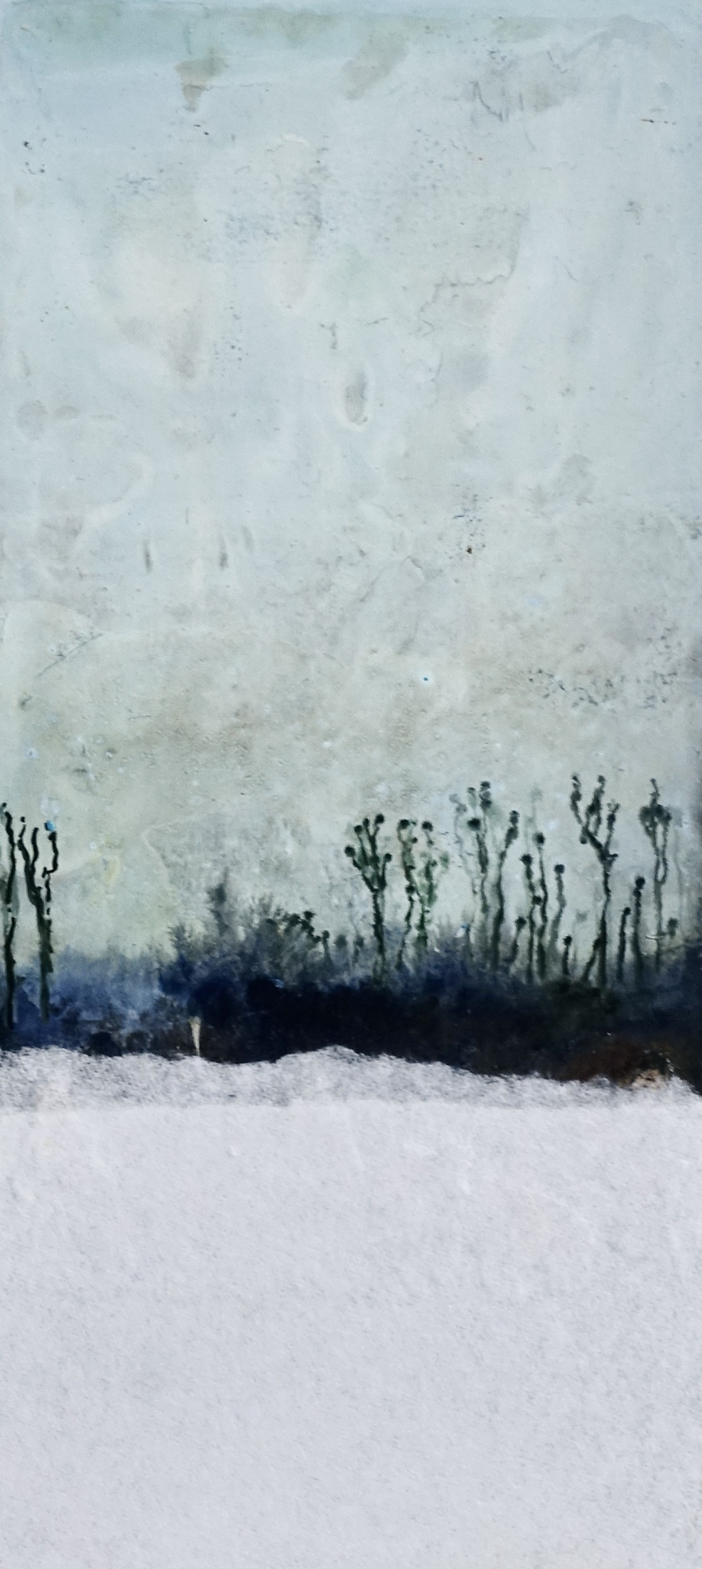
10 x 22 cm

Slide 50
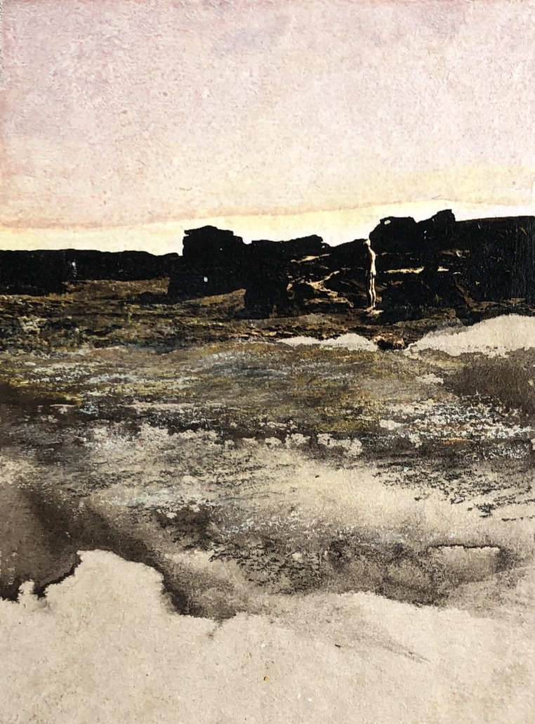
15 x 20 cm

Slide 51

15 x 20 cm

Slide 52

15 x 20 cm

Slide 53

10 x 22 cm

Slide 54

23 x 23 cm

Slide 55

75 x 95 cm

Slide 56

10 x 15 cm

Slide 57

15 x 30 cm

Slide 58

24 x 15 cm

Slide 59

9 x 26 cm

Slide 60

15 x 30 cm

Slide 61

39 x 30 cm

Slide 62

39 x 30 cm

Slide 63

19 x 44 cm

Slide 64

130 x 100 cm

Slide 65

30 x 20 cm

Slide 66
15 x 30 cm

Slide 67

65 x 60 cm

Slide 68

70 x 85 cm

Slide 69

15 x 19 cm

Slide 70

19 x 40 cm

